Slide 1

DATABASE SEARCH & REVIEW
GETTING STARTED GUIDE FOR EMIS WEB USERS

Slide 2
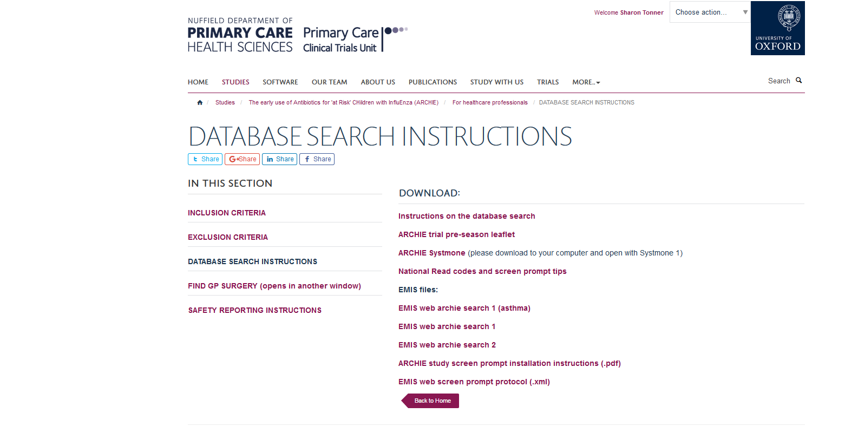
1. Building Your Search
We have built a search appropriate for EMIS Web use and this can be found as an xml file at:
http://www.phctrials.ox.ac.uk/studies/archie/info-for-healthcare-professionals/database-search-instructions.
Please download your search file and save on your computer somewhere you can easily access it.

Slide 3
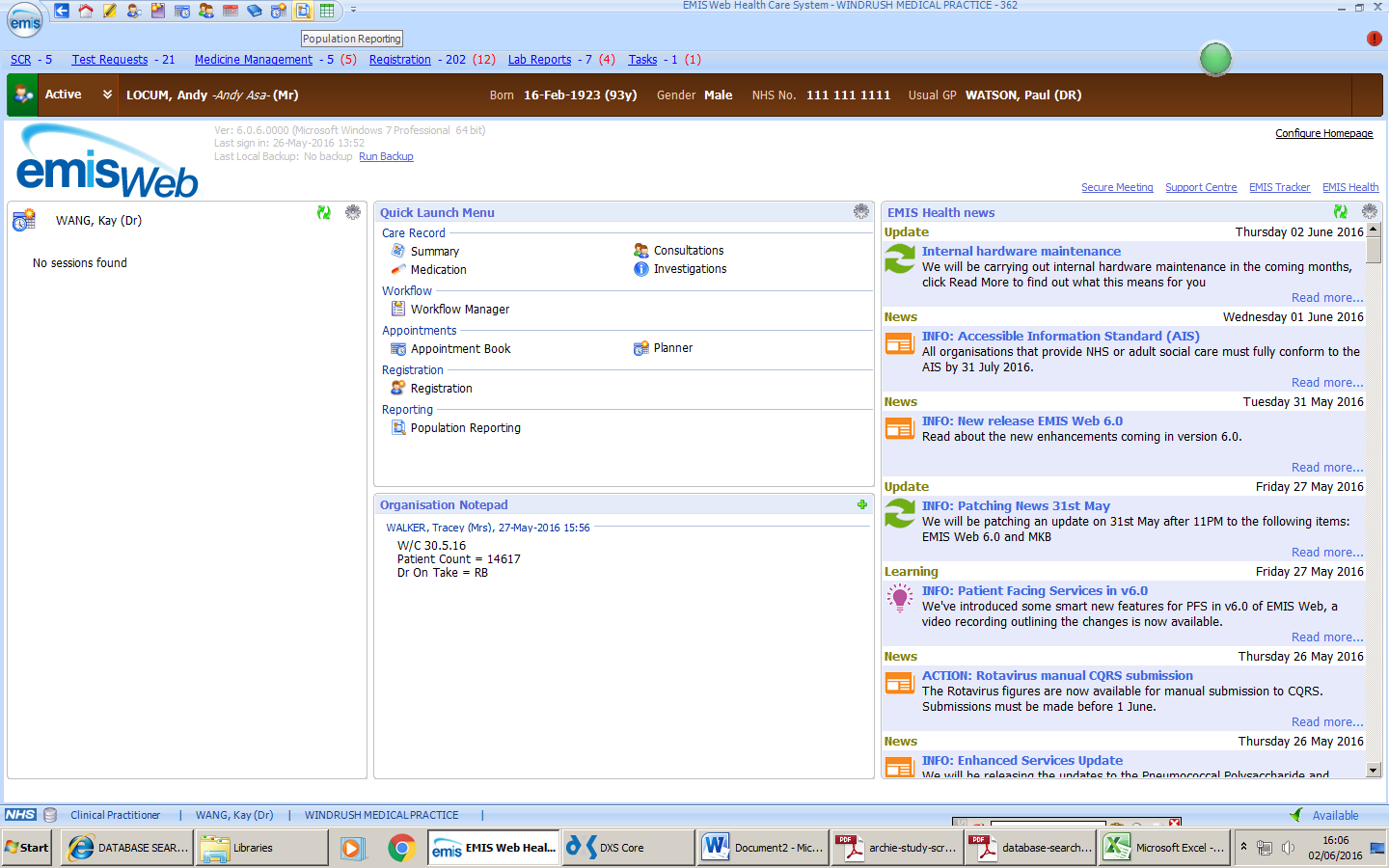
2. Importing Your Search
On your EMIS Homepage go to Population Reporting. You can customize your toolbar to show Population Reporting if it is not already visible.

Slide 4
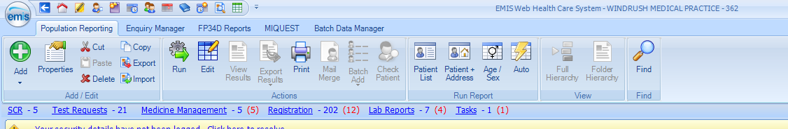
Once in Population Reporting you will see the import button along the top toolbar

Slide 5
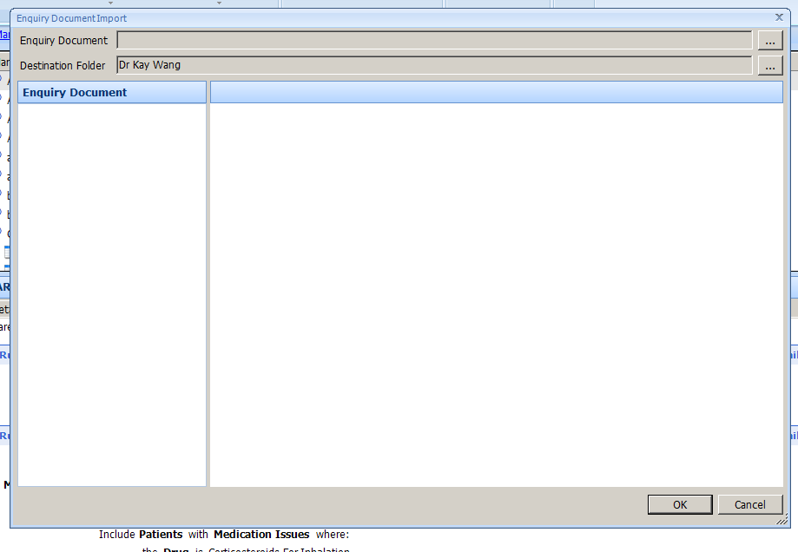
You will then see a blank enquiry document box, click on the top icon box to populate

Slide 6
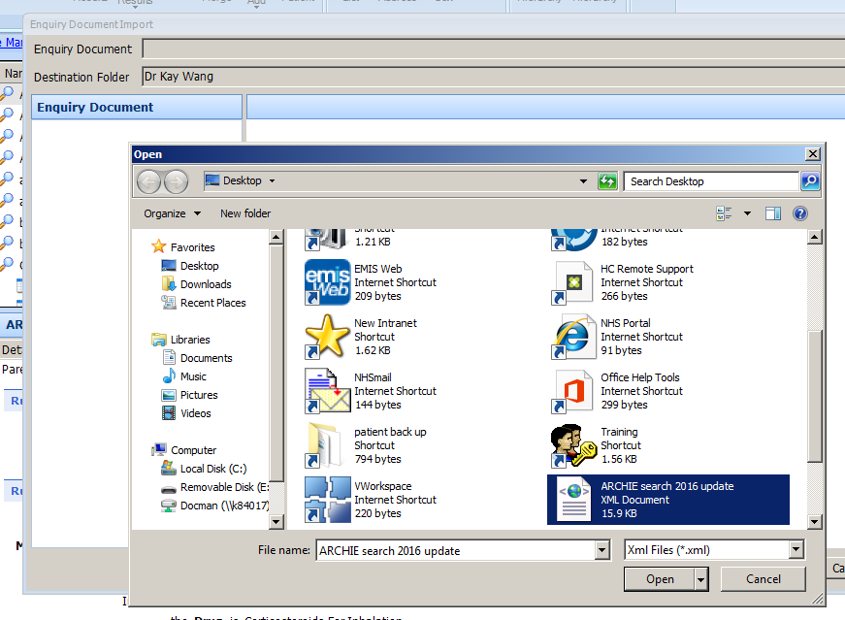
You can now find your saved xml search on your drive
Select your file and open

Slide 7
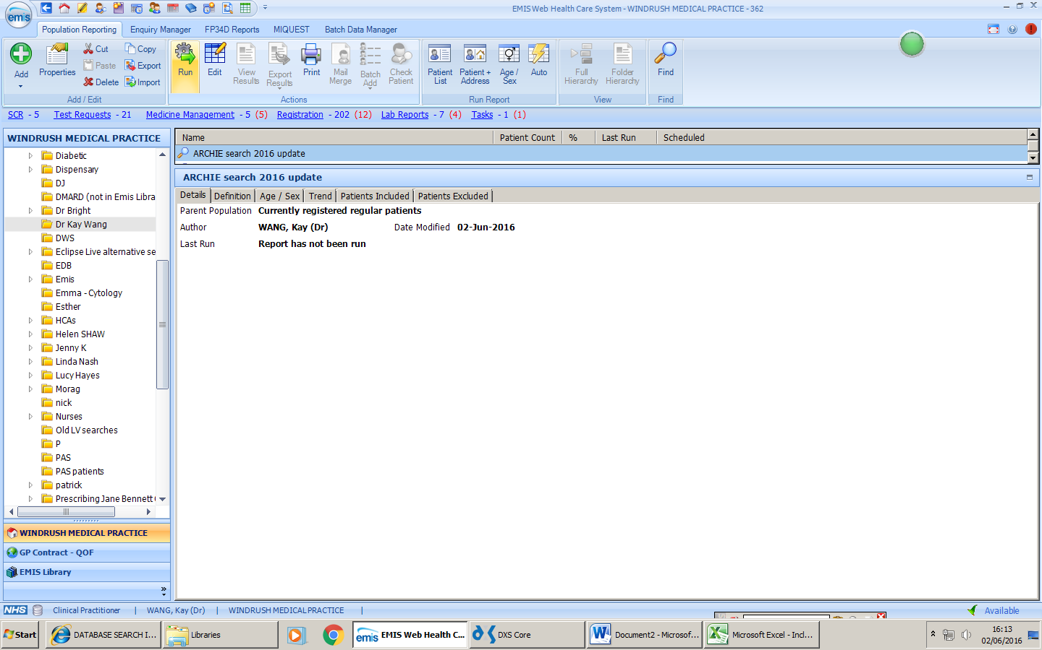
Now you are ready to run your search
A list of patients who are potentially eligible for ARCHIE will now be generated in EMIS for you.

Slide 8
3. Reviewing Your Search
Once EMIS generates your search results you will be able to export in into an excel document. This will allow the clinician who reviews the list to work their way through it to assess if the patient is suitable to for ARCHIE and can make any notes as appropriate.

Slide 9
4. Using Your Search
Once a clinician has confirmed a patient is potentially eligible, your practice can add the Read code for ‘At risk of influenza-related complication’ to that patient’s notes (14Ol.).
This code must be applied manually and you can learn more about doing so at our website:
http://www.phctrials.ox.ac.uk/studies/archie/info-for-healthcare-professionals/database-search-instructions
You may also choose to communicate with the families of the children who have been deemed eligible to take part by (optional):
Posting a copy of the short patient information leaflet and cover letter to inform them the study is occurring over the Autumn and Winter months.
Send text messages to those you have permission to communicate via this route. Approved messages are available on the website (Useful documents)
https://www.phctrials.ox.ac.uk/studies/archie-health-pros/randomise/useful-documents

Slide 10
5. Screen Prompts
For EMIS Web practices, we provide a study screen prompt, which is also available at http://www.phctrials.ox.ac.uk/studies/archie/info-for-healthcare-professionals/database-search-instructions . This is triggered by the above Read code, so please make sure you add this to the medical records of the relevant patients first.
If your practice is using the home visit model please also add the following to your screen prompt:
Please phone the ARCHIE study team on 01865 617 842 or 01865 617 836 if you think your patient may be eligible to take part.
This will allow site GP’s to quickly contact the ARCHIE Trial Office when a potential recruit presents to them.

Slide 11
6. Who should carry out the search?
Any member of staff at site can set up, run the search and then manually apply the codes to the patients if they are deemed capable of doing so by the site Principal Investigator.
The initial database search however MUST be reviewed by a clinician to remove, as far as is possible, any child who would not be suitable to take part due to medical reasons (i.e. history of penicillin allergy) or family circumstances.

Slide 12
7. Further Help
If you are still experiencing difficulties with the database search and cannot find the information you need on the ARCHIE website then please consider one of the following options:
Contact Sharon at Oxford Trial Office (archie@phc.ox.ac.uk ) or Lyn at Bristol Trial Office (archie-trial@bristol.ac.uk) for further advice.
Asking your local IT manager for assistance
EMIS offer free training, your local IT manager should be able to help you to access this.

