Slide 1





The early use of Antibiotics in at Risk CHildren with InfluEnza
Eligibility assessment and recruitment tips
www.archiestudy.com

Slide 2

Dr Kay Wang
ARCHIE Study Chief Investigator
E-mail: kay.wang@phc.ox.ac.uk
Notes:
The ARCHIE study is a double-blind randomised placebo-controlled trial to determine whether early use of the antibiotic co-amoxiclav in ‘at risk’ children presenting with influenza or influenza-like illness reduces the likelihood of these children needing to re-consult due to subsequent deterioration in their clinical condition.
In this presentation, I am going to take you through how to identify suitable patients for the ARCHIE study and some recruitment tips which you may wish to consider.

Slide 3
Patients to consider for ARCHIE
‘At risk’ children aged 6 months to 12 years
Cough AND fever* during influenza season (October to March)
Within 5 days of symptom onset
No known contraindication to co-amoxiclav
Does not require immediate antibiotics or hospitalisation
*Reported as symptom or temperature 37.9°C or higher during consultation
Notes:
To give you a general feel for which patients we are looking for, here is a summary of our main eligibility criteria.
We are looking for ‘at risk’ children between the ages of 6 months and 12 years, who have a medical condition or disability associated with increased risk of influenza-related complications, and who present within the first 5 days of an influenza-like illness, which we define as the presence of cough and fever during influenza season.
In addition, children who take part in our study must not have any known contraindication to co-amoxiclav and must not require immediate antibiotics or hospitalisation based on their clinician’s assessment.

Slide 4
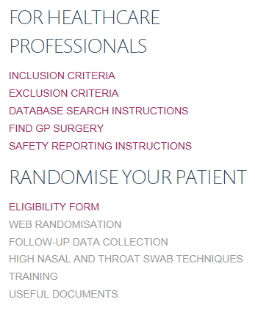
Full eligibility criteria
Notes:
You will be able to view full lists of our inclusion and exclusion criteria by going to our website and clicking on these links.

Slide 5
Full eligibility criteria
Notes:
If you still think the child you are seeing might be eligible to take part in our study, you will need to fill in an eligibility form, which you can access by clicking here.
We ask you to complete the form directly online if possible, although paper copies are provided in the participant study packs. However, if you do fill in a paper copy, please make sure you enter the form online as soon as possible. The study team will be very happy to talk you through this if necessary.

Slide 6
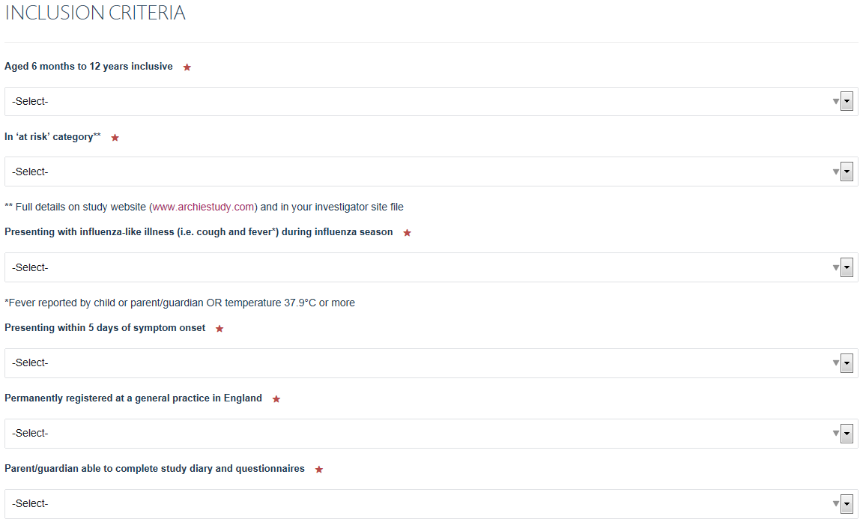
Inclusion criteria
Add screenshot of online version.
Notes:
During flu season, you will probably come across a lot children with influenza-like illness, but we do not expect to fill in an eligibility form for every single one.

Slide 7
Inclusion criteria
Add screenshot of online version.
Notes:
Instead, we suggest that you fill in an eligibility form if the child meets the first 4 criteria on this list.
However, all inclusion criteria listed on this screen must be answered ‘YES’ for a child to actually be eligible to take part in our study.

Slide 8
Key ‘at risk’ categories (see INCLUSION CRITERIA link)
Prematurity in children aged 6 to 23 months – born at less than 37 weeks’ gestation
Immunodeficiency – drugs, haematological conditions, malignancy, sickle cell disease
Diabetes mellitus
Neurological conditions – compromising respiratory function/handling of respiratory secretions
Lung conditions – asthma requiring controller therapy, recurrent viral wheeze, hospitalisation within last 12 months (asthma, bronchiolitis). NOT cystic fibrosis.
Cardiac conditions – being actively managed or monitored by specialist hospital team
Notes:
The inclusion criteria link on our website does provide you with quite a comprehensive list of ‘at risk’ conditions, but here are some of the key ones which you are likely to encounter when recruiting for this trial. Some of these will be familiar to you from current vaccination guidelines, but in addition, we are also including children aged 6 to 23 months who were born prematurely in our definition of ‘at risk’.
We are also happy for you to use your own clinical judgement in deciding which children are at increased risk of influenza-related complications, since we recognise that our list of ‘at risk’ categories is not completely exhaustive. The study team will also be very happy to advise you if you are at all unsure about whether or not a child fits our definition of ‘at risk’.

Slide 9
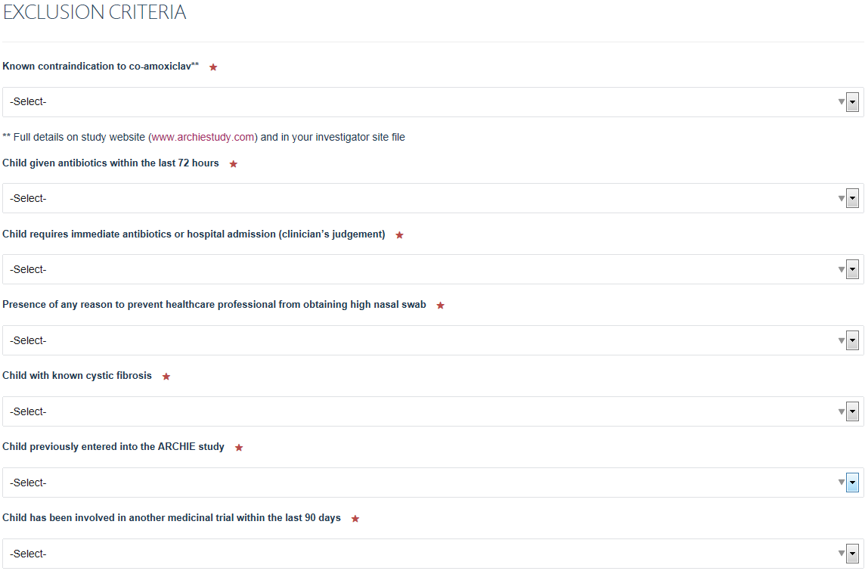
Exclusion criteria
Add screenshot of online version.
Notes:
Here is a list of our exclusion criteria, which must all be answered ‘NO’ for a child to be eligible to take part in our study.
Please do not recruit children from whom you feel it will not be possible to obtain a high nasal swab. The purpose of this swab is to identify children with the influenza virus, as these children will be a key subgroup in our analysis.
Please also do not recruit children with an established diagnosis of cystic fibrosis because current guidelines state that these children should always be given antibiotics if they present with clinical features of an acute respiratory tract infection.

Slide 10
Contraindications to co-amoxiclav See EXCLUSION CRITERIA link
Known hypersensitivity to beta-lactam antibiotics or clavulanic acid
History of jaundice or hepatic impairment due to co-amoxiclav
Severe liver disease with jaundice, increased bleeding risk, bilirubin >50 micromol/litre (2 measurements within last 12 months)
Known or suspected infectious mononucleosis
Known phenylketonuria
Any medication interactions
eGFR less than 30 ml/min/1.73m²
Notes:
As there are quite a few contraindications to co-amoxiclav, our website provides you with a comprehensive list of these, which you can see by clicking on the ‘Exclusion criteria’ link.
Although some children with liver conditions may be suitable for our study, we will be excluding children with severe liver disease and children who have previously experienced liver impairment due to co-amoxiclav.
We will also exclude patients with known or suspected infectious mononucleosis because these patients are more likely to develop a rash if they take co-amoxiclav.
We will also exclude children with phenylketonuria because the study medication contains aspartame. The body converts aspartame to phenylalanine, which these patients are unable to metabolise. Babies in the UK are routinely screened for phenylketonuria on the newborn blood spot test.
Finally, although some children with renal impairment may be suitable for our study, severe renal impairment is a contraindication to co-amoxiclav. If you have any reason to suspect that a child’s EGFR may have deteriorated since his or her most recent measurement, please measure it again before deciding whether it is appropriate to consider this child for our study.

Slide 11
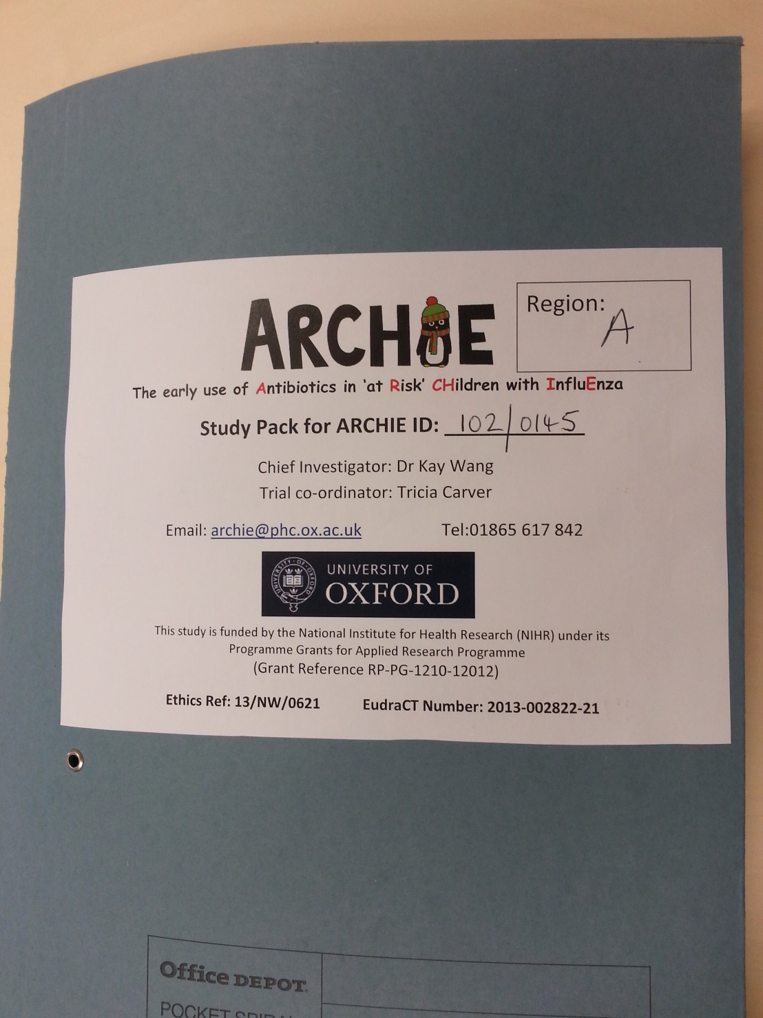

Notes:
If the child is eligible to take part in our study and the child’s parent or guardian gives consent for them to take part, you will need to assign the child an ARCHIE ID number. You will find this on the front cover of the child’s ARCHIE study pack.

Slide 12
Recruitment timeframe
Same day if possible
Following (working) day if still eligibility criteria
Complete eligibility assessment form on the same day as the baseline assessment.
Notes:
Since our study is about early antibiotic use, we ask you to recruit children on the same day as they present if possible. However, if they present later in the day, we would still be happy for you to recruit them the following day, provided they still meet our eligibility criteria. In those circumstances, please only complete our eligibility form on the day that you see the child for their baseline assessment.

Slide 13
Telephone consultation
Initial eligibility assessment
Introduce study (information leaflets on www.archiestudy.com)
Screen prompts (EMIS Web)
Study website
Face to face consultation
Full eligibility assessment
Baseline assessment
Consider booking longer appointment or
appointment at end of surgery
Notes:
If you are recruiting from a GP surgery, one model which we have found works very well is to identify potential participants by telephone triage, who can then be booked in later that day for their baseline assessment.
However, above all, please make sure your colleagues know what types of children we are looking for. As I have mentioned you can remind yourselves of our eligibility criteria any time by going to our website.
Also, if you are an EMIS Web surgery, you may wish to use our study screen prompt, which has kindly been provided to us by qofmasters.com.

Slide 14
Screen prompt (EMIS Web)
Consulting with any of the following:
Cough
Pyrexia
Influenza
Influenza-like illness
Upper respiratory tract infection
Viral illness
Provided:
Age 6 months to 12 years
Coded ‘At risk of influenza-related complications’ (EMISNQAT42)
Notes:
The screen prompt will be triggered by any of these consultation codes, provided the child is aged 6 months to 12 years at the time of the consultation, and has been coded as being ‘at risk of influenza-related complications’, so please make sure you apply this Read code to any children whom your pre-influenza season database search identifies as being in one of our ‘at risk’ groups.

Slide 15
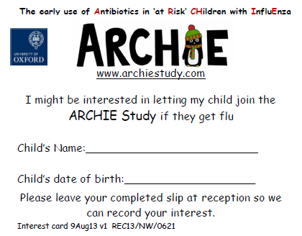
Record interest ‘in principle’
Notes:
Finally, to raise patients’ awareness about our study, we will also provide you with some ARCHIE study interest cards for your reception or waiting room.
This card directs patients to our study website, where they can find out more about our study and even download our study information leaflets.
If they wish to, parents can fill in this card to express their interest ‘in principle’ in letting their child take part. This will allow you to record their interest and flag a reminder in the child’s notes to mention our study if they subsequently present with influenza or influenza-like illness.

Slide 16

Thank you for listening
Notes:
So that covers our eligibility assessment and some recruitment tips for the ARCHIE study. The next video will introduce you to our baseline assessment.

