Slide 1





The early use of Antibiotics in at Risk CHildren with InfluEnza
Baseline assessment
Consent and clinical details
www.archiestudy.com

Slide 2

Dr Kay Wang
ARCHIE Study Chief Investigator
E-mail: kay.wang@phc.ox.ac.uk
Notes:
In this video, I will introduce you to the ARCHIE study baseline assessment, particularly focusing on obtaining consent and baseline clinical details.

Slide 3
Consent
Consent from parent/guardian (compulsory)
  Initial beside each point if agree
+/- assent from child (optional)
Study information leaflets available from www.archiestudy.com
  Ask parents and children to read leaflets before baseline appointment if possible
Notes:
You will need to obtain written informed consent from a parent or guardian for each child who takes part in our study.
You may also obtain written assent from the child if appropriate. However, this is optional. There is no minimum age limit on which children you should seek assent from. We are happy for you to make this judgement.
To help you with this process, we will provide you with our study information leaflets for parents and children, which are also available to download from our website. To save time, you may find it helpful to ask parents and children to read these leaflets before the baseline appointment. This will give them the opportunity to familiarise themselves with our study and think of any questions which they might want to ask before agreeing to take part.

Slide 4
Special points
Notes:
Please note that point 8 on the consent form, which asks parents and guardians if they would be willing for their child to have further follow-up throat swabs, is optional, and children can still take part in our study even if their parents are not willing to give consent for these additional swabs. We also realise that if you are recruiting in an emergency department or GP walk-in centre, it may not be possible for you to offer parents and children this option.
Please also pay special attention to the instructions at the bottom of each consent and assent form, which will tell you what you need to do with the various copies. The instructions will differ depending on whether or not you are recruiting from a GP surgery.

Slide 5
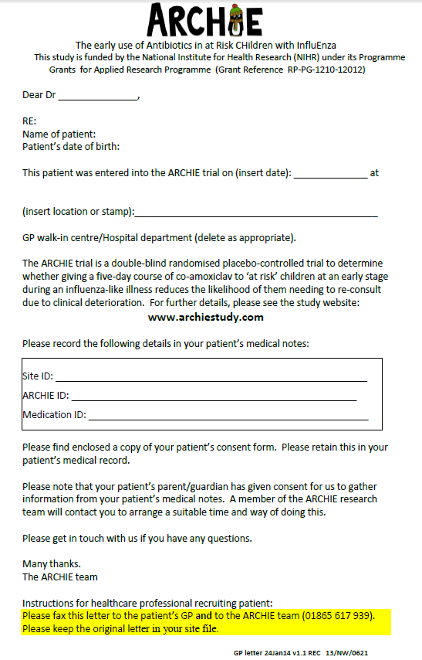
GP surgery notification letter
Notes:
If you are not recruiting in a GP surgery, you will need to notify the child’s GP that they have been recruited into our study. We will provide you with a GP surgery notification letter for this purpose. Please complete the child’s details on this letter and then fax one copy to the child’s GP surgery and another to the primary care clinical trials unit in Oxford.

Slide 6
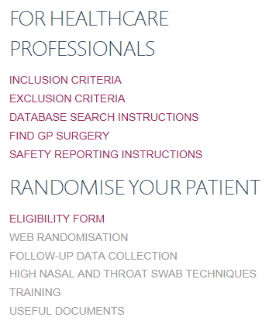
Finding GP surgery contact details
Notes:
To find the contact details of the child’s GP surgery, you can go to our website and click on the ‘find GP surgery’ link. This will take you to the NHS Choices website. To find the details you need, type the name of the GP surgery into the search box.

Slide 7
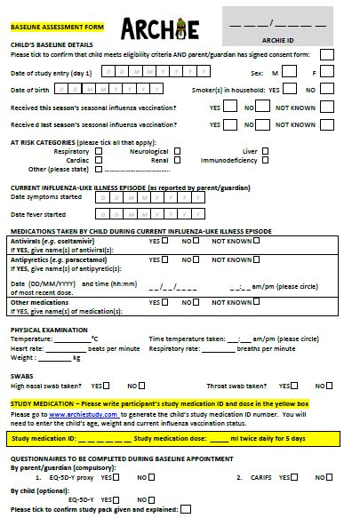
Notes:
So having done this, you are now ready to start the baseline assessment.
We will provide you with a paper version of the baseline assessment form in the child’s study pack, which is on just on single side of A4. Some people may prefer to complete this paper version first and enter the form online later.

Slide 8
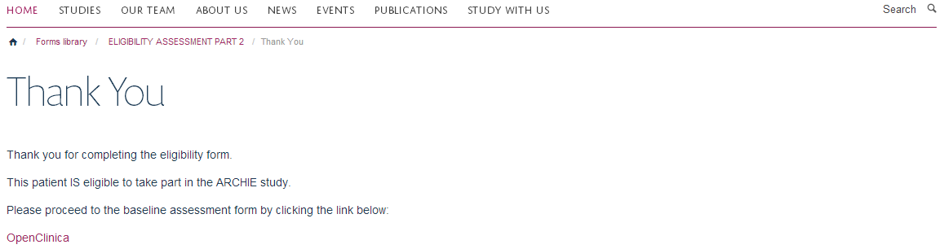

Accessing online baseline assessment form
Notes:
However, if you have access to our website, you may prefer to complete the form directly online, as this will reduce the likelihood of data entry errors and save you from having to archive the paper form.
To access the online form, all you need to do is click on the ‘OpenClinica’ link which you will see once you submit your eligibility form.

Slide 9
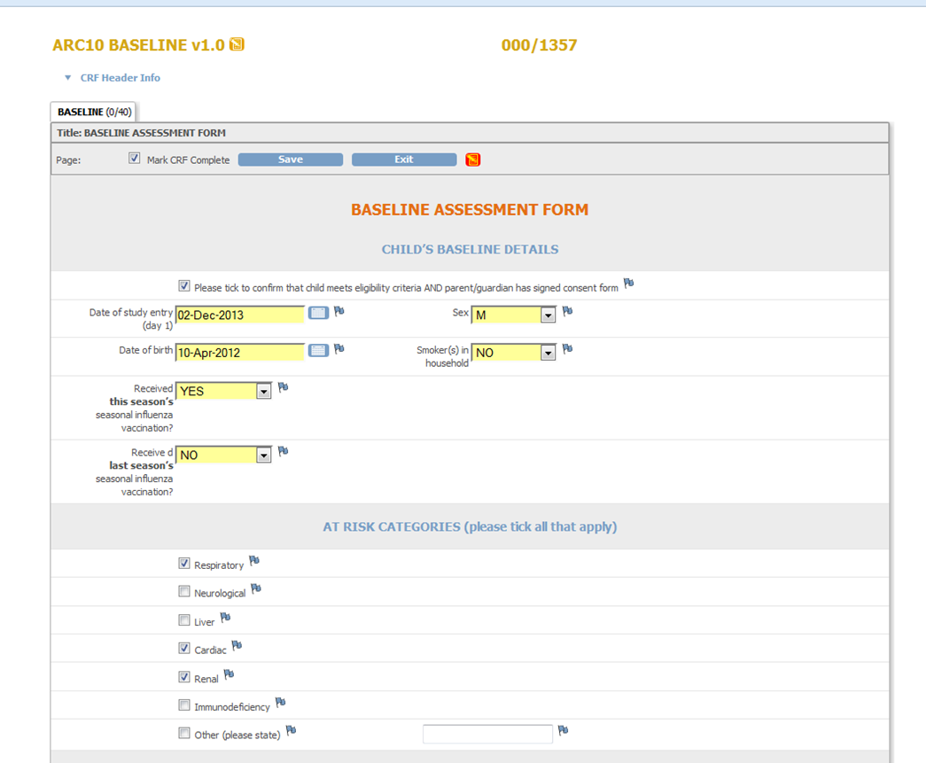
Patient details
Notes:
Here is what our online baseline assessment form looks like.
The first part consists of recording some fairly straightforward demographic details and recording the date of study entry, which will be day 1 of the study.
The key pieces of information you will need to randomise the child are: date of birth (to calculate the child’s age), and whether or not the child has received the current season’s influenza vaccination. If you are not sure of the answer to the latter question, please select ‘not known’. You will still be able to randomise the child.

Slide 10
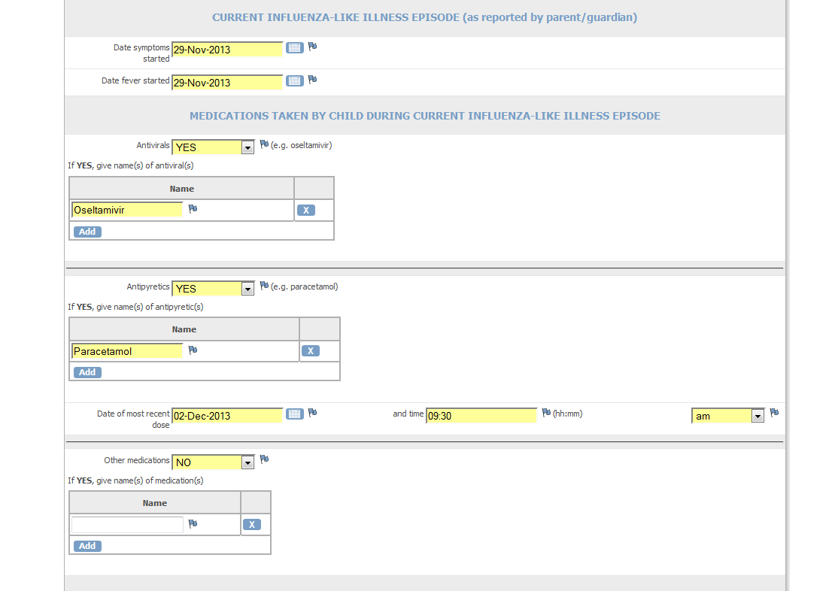
Current influenza episode
Notes:
Next, you will next need to record when the child’s influenza-like illness (ILI) started and, in particular, when their fever started. Please also indicate if the child has taken any medications so far for their current ILI episode.

Slide 11
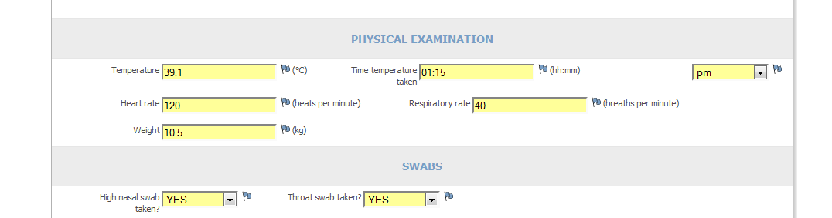
Temperature
Use any thermometer appropriate for child’s age
  Axillary thermometer provided in each study pack
Record time using 12 hour clock
Select am/pm
Notes:
After this, we ask you to perform a very simple clinical examination, starting off with taking the child’s temperature.
To measure the child’s temperature, you can use any thermometer appropriate for the child’s age, but I will just mention at this point that we also provide an axillary thermometer in each child’s study pack. The main purpose of this thermometer is to allow parents to monitor their child’s temperature at home. However, you may also wish to use it during this baseline appointment so that you can show the parent how to use it at the same time.
Please also remember to record the time you measure the child’s temperature using the 12 hour clock and select either am or pm from the box on your right hand side.

Slide 12
Heart rate and respiratory rate
Count for one minute
Notes:
Next, we ask you to record the child’s heart rate and respiratory rate. Please try to count these for a full minute.

Slide 13
Weight
In babies:
  (Adult’s weight + baby’s weight) – Adult’s weight
  Use latest weight recorded in red book
Notes:
You will also need to record the child’s weight.
This should be straightforward in most cases, but if you do not have facilities for weighing babies, we would be happy for you to either estimate the baby’s weight using the subtraction technique we have outlined here, or record the most recent weight written in the child’s red book, provided you are happy that this is up to date.

Slide 14
Swabs
Must obtain high nasal swab in order to randomise child
Swabs will be analysed in Liverpool
Notes:
Before proceeding to randomisation, you must obtain a high nasal swab from the child, since this is the swab which we will use to detect the influenza virus. If you do not manage to obtain a high nasal swab, please do not proceed to randomising the child. However, if you obtain the high nasal swab but not the throat swab, please still go ahead and randomise the child.
The swab kits provided in each study pack contain everything you need to take and package the swabs. Swabs will be analysed in Liverpool. Postage is also already paid. There is a separate video on our website which explains how to take these swabs.

Slide 15

Study medication
Notes:
The study medication field will only appear if you click ‘yes’ beside the ‘high nasal swab’ question.
Clicking on our website link will then direct you to our web based randomisation system.

Slide 16

Thank you for listening
Notes:
So you are now ready to randomise the child. The next video will explain how to use our online randomisation system and how to allocate study medication to the child.

