Slide 1





The early use of Antibiotics in at Risk CHildren with InfluEnza
Baseline assessment
Study medication
Contact card
www.archiestudy.com

Slide 2

Dr Kay Wang
ARCHIE Study Chief Investigator
E-mail: kay.wang@phc.ox.ac.uk
Notes:
In this presentation, I will explain how to use our online randomisation system, which is called Sortition. I will also explain how to allocate and dispense study medication to study participants.

Slide 3
Study medication dosing regimen
Age | Dosing regimen
6 months to 23 months 6.0 to 7.9 kg 8.0 to 10.9 kg 11.0 to 12.9 kg | 1 ml twice daily for 5 days 1.5 ml twice daily for 5 days 2 ml twice daily for 5 days
2 to 6 years | 2.5 ml twice daily for 5 days
7 to 12 years | 5 ml twice daily for 5 days
Notes:
Here is an overview of our study medication dosing regimen. Dosing is by age in children aged 2 to 12 years and by weight in children aged 6 to 23 months. We will provide you with bottles of study medication in powdered form. The powder will either be co-amoxiclav or a matching placebo.

Slide 4
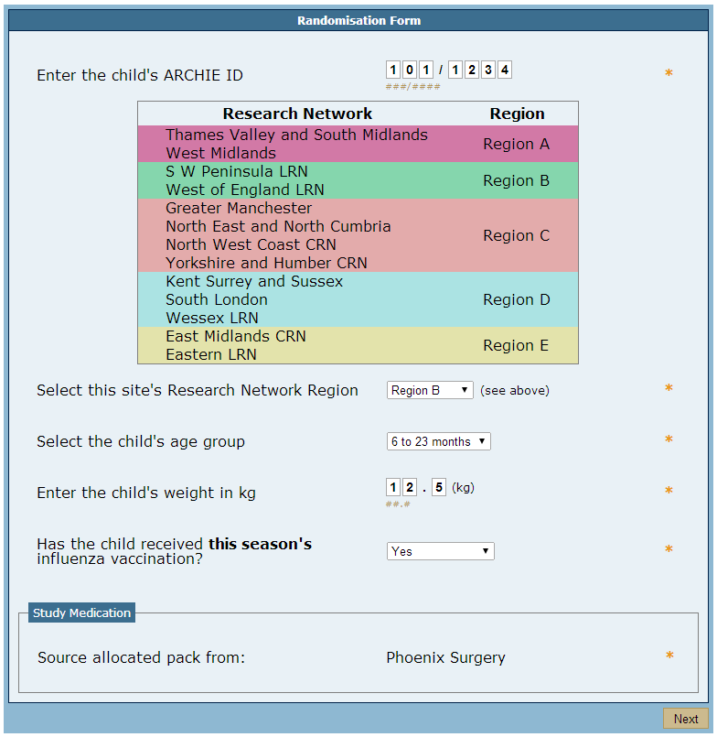
Notes:
To work out your participant’s medication dose and which bottle you need to give the child, Sortition, our randomisation system, will ask you to enter the child’s age, weight and influenza vaccination status. You will be asked to choose between two age groups: either 6 to 23 months or 2 to 12 years.
Sortition will also ask you to enter your recruiting site’s research network region. To find this, you can either refer to the table at the top of the randomisation form….

Slide 5


Notes:
.. Or look at the front cover of the participant’s study pack, which will have the region written in the top right hand corner.

Slide 6
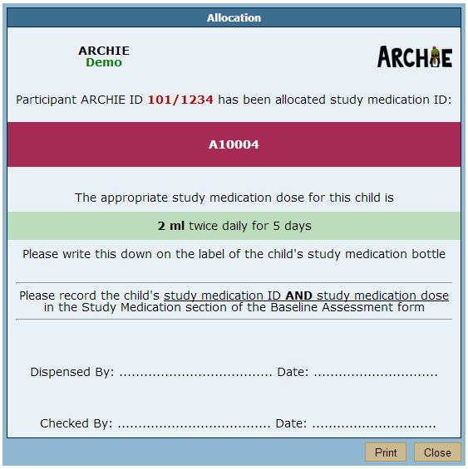
Notes:
Once you have entered the child’s details, Sortition will provide you with a medication ID number for the child and tell you the dose of medication which the child needs to take.
If you have access to a printer, you can print this off, sign it and file it together with your drug accountability documents. If possible, get a colleague to check the bottle you dispense with you, but this is not compulsory.

Slide 7
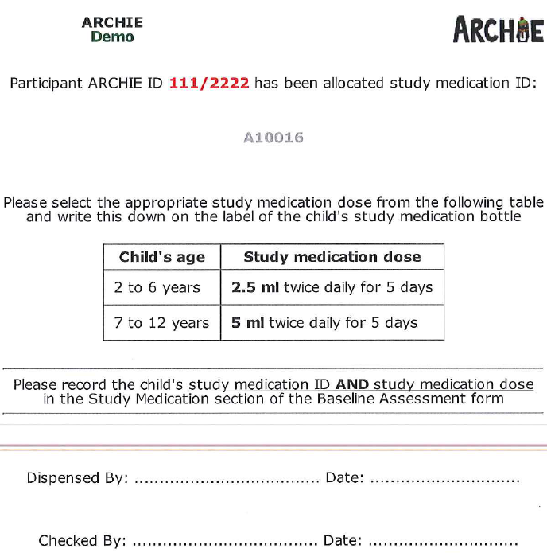
Notes:
Please note that if the child is aged between 2 to 12 years, you will need to manually select between these two dosing options, depending on the child’s age.

Slide 8
Notes:
Please do this by crossing through the option which does not apply to that child.
If possible, please print this off, sign it and file it together with your drug accountability documents.

Slide 9
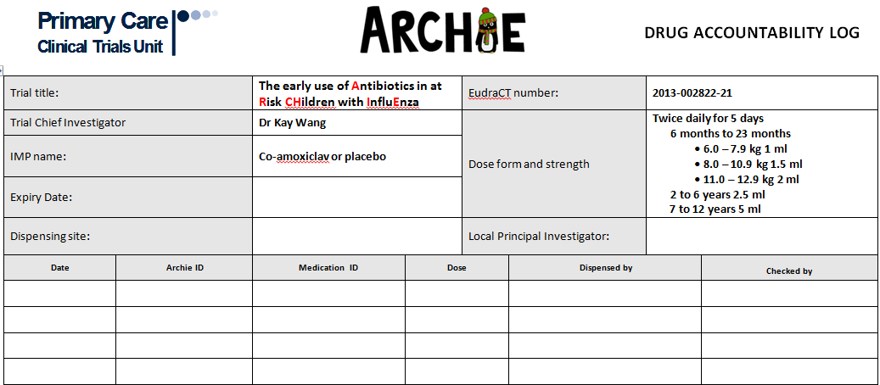
Drug accountability log
Notes:
However, if you do not have access to a printer, please enter the child’s ARCHIE ID and medication details instead on your drug accountability log. You may also wish to get a colleague to double check the bottle you dispense, but this is not compulsory.

Slide 10
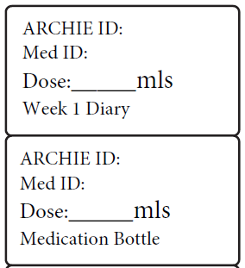
ID number stickers
Notes:
In the pocket inside the front cover of the study pack, you will find some stickers which you can use to record the child’s ARCHIE ID, medication ID, medication dose.
You might actually find it helpful to do this before you dispense the study medication, particularly if you keep the medication in a different room to where you are recruiting the child. The bottom of the sticker tells you where you need to attach it once you have filled it in.

Slide 11
Dispensing study medication
Need 61 ml water for contents of one bottle
Measuring cup and syringe provided
Add half of water first and shake bottle
Add remaining water and shake bottle again
Affix medication bottle sticker
Notes:
This slide summarises our instructions for dispensing study medication. You will also find these in your participant’s study pack.
In summary, you will need to add 61 ml of water to each bottle. Cold drinkable tap water will do. To help you measure this out, we have provided you with a 60ml measuring cup and a syringe to measure the extra ml.
To make sure that the powder and water are thoroughly mixed, add about half the water to the bottle first, replace the cap and shake the contents.
Then repeat with the rest of the water and affix the medication bottle sticker.
Please ask the child’s parent to give them the first dose of medication as soon as possible, or even during the appointment if possible. Please also tell the child’s parent to give the child one dose of medication twice a day, making a total of 10 doses. They will need to discard any leftover medication once they have given these 10 doses.

Slide 12
Instructions for parent/guardian
Give first dose asap
Explain dosing regimen
Discard any leftover medication after 10 doses given
If child vomits within 30 minutes of dose can give another dose

Slide 13

Contact card
Insert child’s name
Notes:
Please also remember to fill in the child’s details on their ARCHIE study contact card. You will find this in your participant’s study pack. Parents can carry this card in their wallet in case they need to seek medical advice at a healthcare facility which is not taking part in the ARCHIE study.

Slide 14
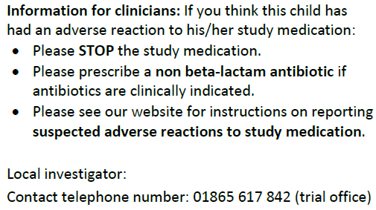
Contact card
Insert phone number of GP surgery or hospital
Notes:
Please remember to write the phone number of the GP surgery or hospital from which you recruited the child in the space next to ‘Local Investigator’. We have also provided a contact telephone number for the study team.

Slide 15

Thank you for listening
Notes:
So that covers how to randomise, allocate and dispense medication to study participants. The next video will explain our study questionnaires, study diary and how to arrange follow-up appointments.

