Slide 1





The early use of Antibiotics in at Risk CHildren with InfluEnza
Baseline assessment
Questionnaires and diaries
Arranging follow-ups
www.archiestudy.com

Slide 2

Dr Kay Wang
ARCHIE Study Chief Investigator
E-mail: kay.wang@phc.ox.ac.uk
Notes:
In this presentation, I will go through the final part of our baseline assessment, which will involve asking parents and children to complete our study questionnaires, explaining our study diaries and arranging the week 1 and week 2 follow-up telephone calls.

Slide 3

While you prepare study medication….
Ask parents and children to fill in their questionnaires and contact information form
Let parents and children look at our Study Diary – Instructions and Overview
Notes:
The good news is that you can save quite a bit of time in this part of the assessment by asking parents and children to fill in our study questionnaires and look at our study diary instructions while you are preparing the child’s study medication.

Slide 4
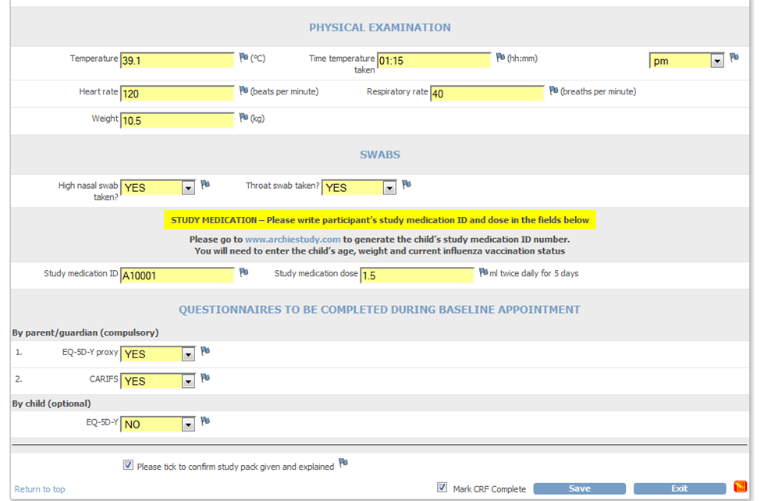
Questionnaires
Notes:
You will see on the baseline assessment form that parents need to complete two questionnaires on their child’s behalf: the EQ-5D-Y proxy questionnaire and CARIFS questionnaire, which I will go through shortly.
If children are able to and want to, they can also complete the EQ-5D-Y questionnaire about themselves, but this is optional.
You will find copies of all these questionnaires in the participant’s study pack, along with ARCHIE ID stickers for you to attach to each questionnaire.

Slide 5
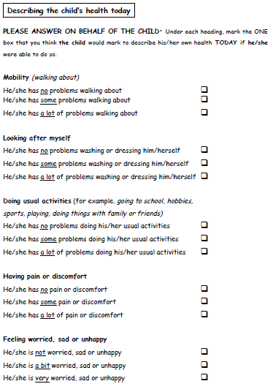
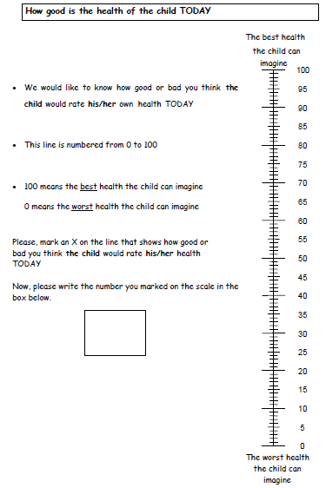
EQ-5D-Y proxy (parent/guardian)
Notes:
The EQ-5D-Y proxy questionnaire consists of 5 questions and a 0 to 100 visual analogue scale. We are aware that this is rather a generic questionnaire and, as a result, some parents may not feel that certain items are particularly relevant to their child. For example, some children may have limitations in their ability to walk about or look after themselves as a result of their age or their underlying medical condition, and not because of their influenza-like illness. If this is the case, please still ask the child’s parent to select whichever answer they feel best applies to their child and to only select one answer to each question. We will still be able to interpret their answer using the information we collect from subsequent questionnaires and their child’s medical notes.

Slide 6
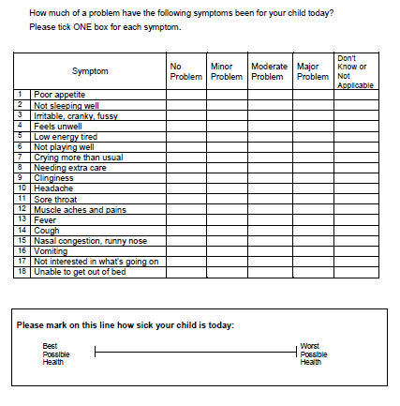
CARIFS (parent/guardian) Canadian Acute Respiratory Infections and Flu Scale
Notes:
The CARIFS questionnaire is slightly longer, but is a more disease-specific questionnaire than the EQ-5D-Y proxy. Again please ensure that parents answer every question and only select one answer to each question.

Slide 7
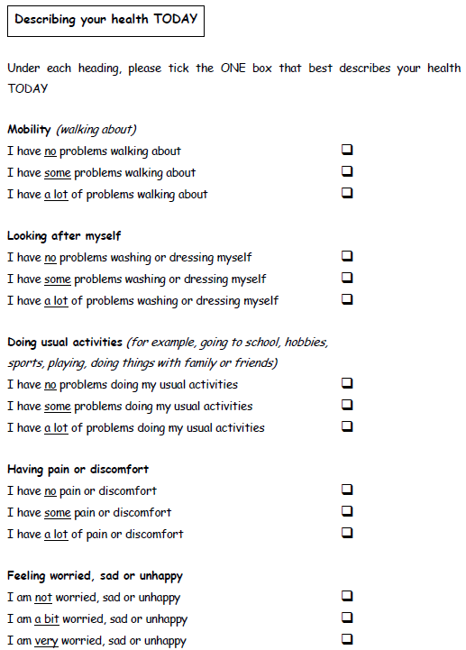
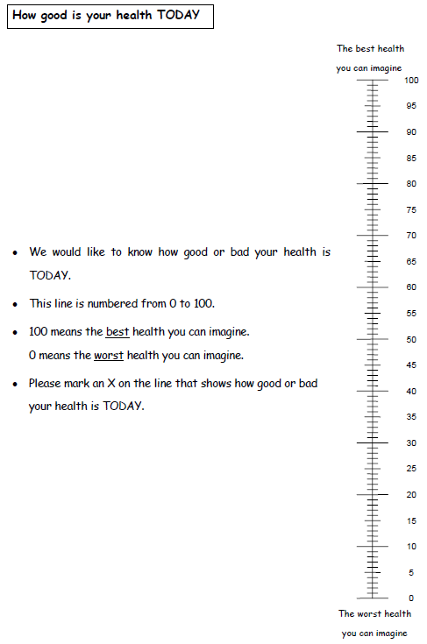
EQ-5D-Y (child, optional)
Notes:
Children may complete the EQ-5D-Y questionnaire themselves if they wish to do so, but as I said earlier, this is optional.

Slide 8
Contact information
Participant details
Name
NHS number
Contact details for participant’s GP
Name
Address
Telephone number
Notes:
Please also ask parents and guardians to fill in their child’s details and contact details for their child’s GP on the form we provide with the questionnaires. This will help us remind participants’ GPs when their medical notes reviews are due and assist the GPs of participants recruited from non GP surgery settings with their medical notes reviews.

Slide 9
Study diaries
Weeks 1, 2, 3, 4 (for parent/guardian to complete)
Postal return is preferred option
Pre-paid envelopes x4
Study diary for child (optional)
Notes:
Next, I would like to explain our study diaries, which you fill find in the participant’s study pack.
There are actually 4 weekly diaries to complete. Each one comes with a pre-paid envelope so parents can return each week’s diary as it is completed. As an alternative, parents may scan their diaries and return them to the study team by e-mail, but they will probably find it easier to send us their paper copies by post, and this would be our preferred option, too.
We do provide a study diary for children to fill in, but this is optional.

Slide 10
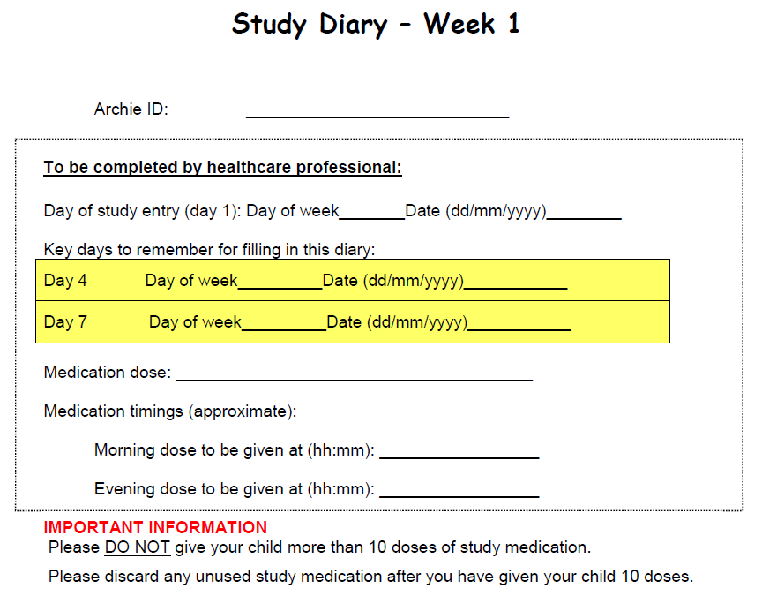
Study diary (parents/guardians)
Notes:
This is the front cover of the week 1 diary. You will see that there are two key days on which parents will be required to complete some additional questionnaires, as per the instructions in the diary. These key days will vary from week to week.
The week 1 diary cover also provides spaces for you to complete the child’s medication dose and timings. You can either write these in the spaces provided….

Slide 11
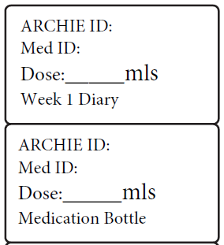
ID number stickers
Notes:
..or attach the week 1 diary sticker which you filled in earlier when preparing the child’s study medication.

Slide 12
Contents of diary
Duration of illness
Symptoms
Temperature
Study medication
Other medication
Weekly questions
Potential side-effects
Daily activities and childcare
Health service contacts
Questionnaires
EQ-5D-Y proxy: days 4, 7, 14 and 28
CARIFS: day 7
Notes:
This is an overview of the contents of our study diary.
Parents will be asked to record their child’s symptoms, temperature and any medication they give their child for the duration of the child’s influenza-like illness.
Then, at the end of each week, they will be asked to answer some questions about potential side effects of study medication, daily activities and childcare, and health service contacts.
On certain key days, they will also be required to complete the EQ-5D-Y proxy and CARIFS questionnaires, which they previously completed at baseline.
Each diary will come with a clear set of instructions telling parents exactly what to complete and when.

Slide 13
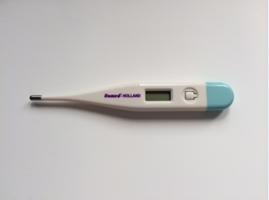
Electronic axillary thermometer
Notes:
Along with the diary, we also provide an electronic axillary thermometer, which parents can use to record their child’s temperature. Please emphasise to parents that the thermometer needs to be held in the child’s armpit for 2 minutes each time they measures the child’s temperature.

Slide 14

Study diary for child (optional)
Notes:
If children would like to, they can use sticker charts to keep track of their study medication.

Slide 15
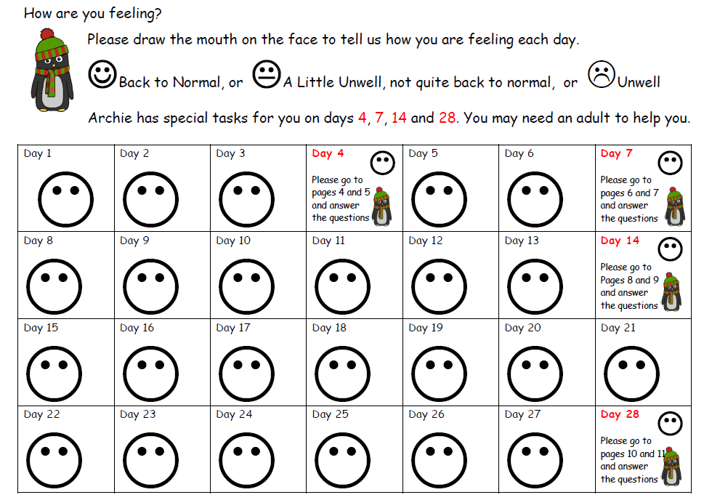
Study diary for child (optional)
Notes:
And use this face chart to record how they are feeling each day. However, these are optional, so children do not have to use them unless they want to.

Slide 16
Follow-ups (all participants)
Week 1 (telephone)
Day 7 to 10
Week 2 (telephone)
Day 14 to 17
Day 1 = date of randomisation
(Mobile phone text reminders – days 4, 7, 14, 21, 28)
Notes:
Finally, you will need to arrange follow-up appointments for the child.
There are two follow-ups in this study at week 1 and week 2, both of which will take place by telephone.
The week 1 follow-up can be done any time from day 7 to 10 inclusive and the week 2 follow-up anytime from day 14 to 17 inclusive. Day 1 is the day the child enters the study.
If you have a system which allows you to set up mobile phone text reminders, you may wish to set these up to remind parents to fill in the additional questions and questionnaires in their study diaries. However, please do not feel you have to do this if it is too much hassle. You will have opportunities to remind parents about these anyway during the week 1 and week 2 telephone follow-ups.

Slide 17
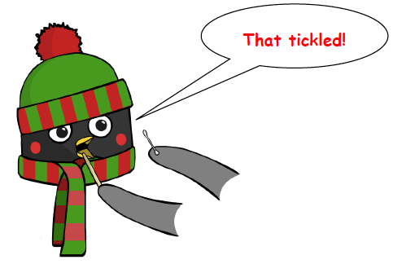
Follow-up throat swabs (optional)
3, 6 and 12 months (+/- 2 weeks)
Study team will remind GP surgery when swabs are due and send swab kits
Notes:
If the child’s parent agreed to them having follow-up throat swabs, the study team will remind you when these are due and send you the kits you need to obtain these swabs.

Slide 18
Thank you for listening
Notes:
So that brings us to the end of the baseline appointment. In the next presentation, I will go through how to conduct the telephone follow-up appointments and report adverse events.

