Slide 1
The early use of Antibiotics in at Risk CHildren with InfluEnza
Follow-up assessments
Adverse Event Reporting
www.archiestudy.com

Slide 2
Dr Kay Wang
ARCHIE Study Chief Investigator
E-mail: kay.wang@phc.ox.ac.uk
Notes:
As I mentioned in my previous presentation, there are two follow-up assessments in this study, both of which take place by telephone, and in this presentation, I will explain how to conduct these assessments and how to report adverse events.

Slide 3
Follow-up assessments
Telephone follow-ups
Week 1 (day 7 to 10)
Week 2 (day 14 to 17)
Objectives
Safety monitoring
Reminders to complete and return diaries
(Consent for additional throat swabs)
Notes:
Just to recap we will ask you to conduct two follow-up assessments one week and two weeks after study entry (which is day 1).
The main objectives of these follow-ups are to monitor participants’ safety and to remind parents to complete and return their study diaries. Also, if parents did not give consent for their children to have additional throat swabs at the baseline assessment, you will have the opportunity to ask them again
during either or both of these follow-up appointments.

Slide 4
Before you pick up the phone….
….check if parent gave consent for additional throat swabs
Notes:
So before you pick up the phone, please check the child’s consent form to see if the parent gave consent for these swabs at the time of study entry.

Slide 5
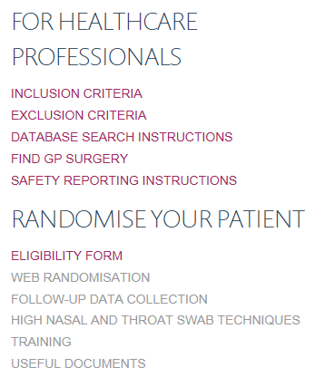
Follow-up forms
Notes:
You can access our week 1 and week 2 follow-up forms from our website by clicking on our Follow-up data collection link.

Slide 6
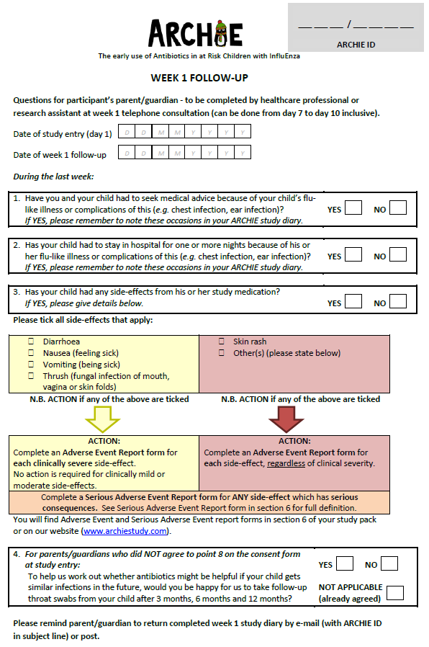
Notes:
We also provide paper versions of our follow-up forms in each participant’s study pack. Again, each form is on just one side of A4, and if you wish, you can complete this paper version first and enter it online later. However, if you do have access to our website, you may find it more convenient to enter your data directly online, and the study team will be happy to assist you with this if necessary.

Slide 7
Notes:
To complete the form online, you will need to find the child’s ARCHIE ID in the Study Subject ID column. You will then be able to select the week 1 or week 2 follow-up form as appropriate. Don’t worry about the week 3 and week 4 columns. These are for the study team’s use only.

Slide 8
Follow-up (Q1-3)
Notes:
The first three questions of each follow-up form are intended to monitor children’s safety and potential side effects from study medication. If the parent reports any side-effects, you will need to take action as appropriate.

Slide 9
Which side-effects do I report?
Common known side-effects
Diarrhoea, nausea, vomiting and thrush
Only report if:
Clinically severe (based on clinician’s judgement)
Result in a serious adverse event
Other side-effects
Always report
Notes:
Diarrhoea, nausea, vomiting and thrush are well recognised side-effects of co-amoxiclav, so we will not require you to report these as adverse events if they are only of mild to moderate severity. However, if any of these side-effects are clinically severe or result in a serious adverse event, we will need you to report them.
All other side-effects must be reported as adverse events, regardless of their clinical severity.

Slide 10
Adverse event reporting
Record each adverse event on participant’s Adverse Event Report Log (study pack)
Complete and submit an Adverse Event Report Form (online)
Notes:
To report an adverse event, firstly record the event on your participant’s Adverse Event Log, which you will find in their study pack.
Then, complete and submit our online adverse event report form.

Slide 11
Follow-up forms
Notes:
You can access this by clicking on our Follow-up data collection link.

Slide 12
Notes:
You will then need to find the child’s ARCHIE ID in the Study Subject ID column and select AE to open the Adverse Event Form.

Slide 13
Serious adverse event reporting
Report serious adverse events within 24 hours of becoming aware of the event
Notes:
If you need to report a serious adverse event, you will need to download a serious adverse event report form from our useful documents link and complete a paper copy. Instructions are provided on the form, but please contact us if you need any help. Please make sure you report any serious adverse events within 24 hours of becoming aware of the event.

Slide 14
Study diary reminders
Week 1
Check parent/guardian has completed:
Day 4 and day 7 questionnaires
Weekly questions
Week 2
Check parent/guardian has completed:
Day 14 questionnaire, weekly questions
Remind parent/guardian to complete:
Week 3 and week 4 diaries (including day 28 questionnaire)
Notes:
Regarding study diary reminders, here is a summary of things you may wish to check at the week 1 and week 2 telephone follow-ups. By the end of week 1, parents should have completed their day 4 and day 7 questionnaires as well as the daily and weekly questions in their diary. By the end of week 2, parents should also have completed the day 14 questionnaire. You may also take this opportunity to remind parents to complete and return their week 3 and week 4 diaries.

Slide 15
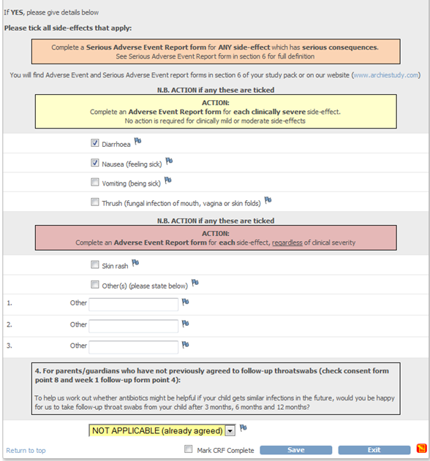
Additional throat swabs (Q4)
Obtain written consent at 3 month appointment
Notes:
Finally, just to mention briefly that if a parent gives verbal consent for their child to have additional throat swabs during either telephone follow-up appointment, the healthcare professional who takes the 3 month throat swab will need to gain written informed consent at that time. As I mentioned earlier, the study team will let you know when the 3 month follow-up swab is due.

Slide 16
Thank you for listening
Notes:
So that covers our follow-up assessments and safety reporting procedures. You are now ready to start recruiting for the ARCHIE study. The only area left to cover now is how to perform our medical notes reviews, and this will be covered in a forthcoming presentation.

