Slide 1





The early use of Antibiotics in at Risk CHildren with InfluEnza
Medical notes review
www.archiestudy.com

Slide 2

Dr Kay Wang
ARCHIE Study Chief Investigator
E-mail: kay.wang@phc.ox.ac.uk
Notes:
In this presentation, I will explain how to do the medical notes reviews for children you recruit into the ARCHIE study. It is very important that a notes review is completed for every child who enters our study because this is how we will gather data for our primary outcome.
Our primary outcome for this study is re-consultation due to clinical deterioration within 28 days of study entry. Therefore, to ensure that all relevant data are available, the study team will ask you to conduct the child’s medical notes review around 3 months after they entered the study.

Slide 3

Accessing online notes review
Notes:
To access our online notes review forms, you will need to go to our website and click on the follow-up data collection link.

Slide 4
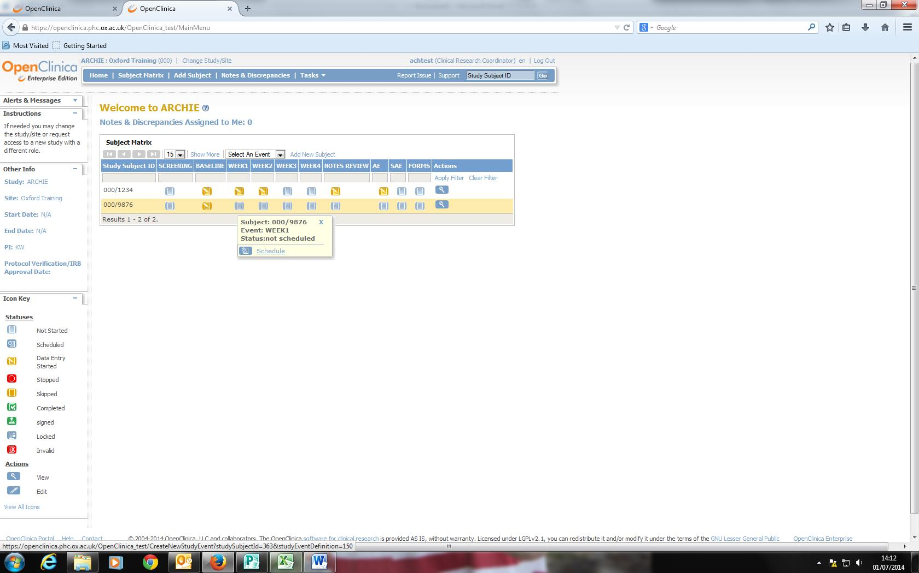
Notes:
This will take you through to the OpenClinica screen, where you will need to find the child’s ‘ARCHIE ID’ in the ‘Study Subject ID’ column and then click on their notes review icon.

Slide 5
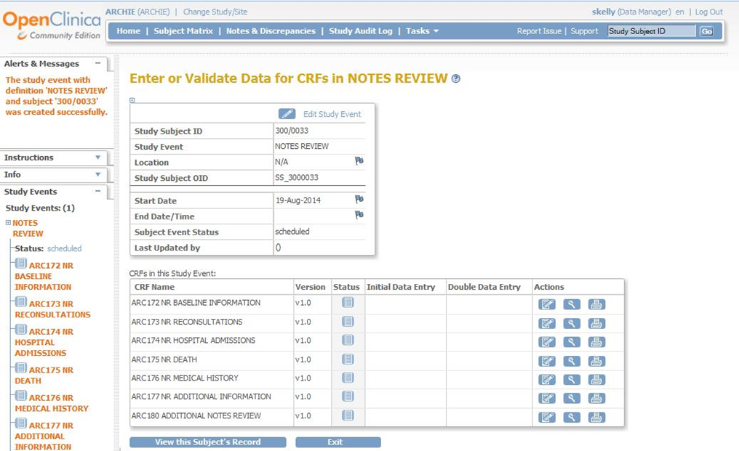
All children
Space for extra information if needed
Additional throat swab participants only
Notes:
This will take you through to this screen, which displays our notes review case report forms (CRFs).
The first 5 CRFs on baseline information, re-consultations, hospital admissions, death, and medical history, will need to be completed for all children.
There is also a CRF called ‘additional information’ which you may or may not need. The purpose of this CRF is to provide you with space to enter extra information if you were unable to fit everything into the other CRFs.
Finally, there is an ‘additional notes review’ CRF, which you will only need to fill in if your participant had follow-up throat swabs after study entry.

Slide 6
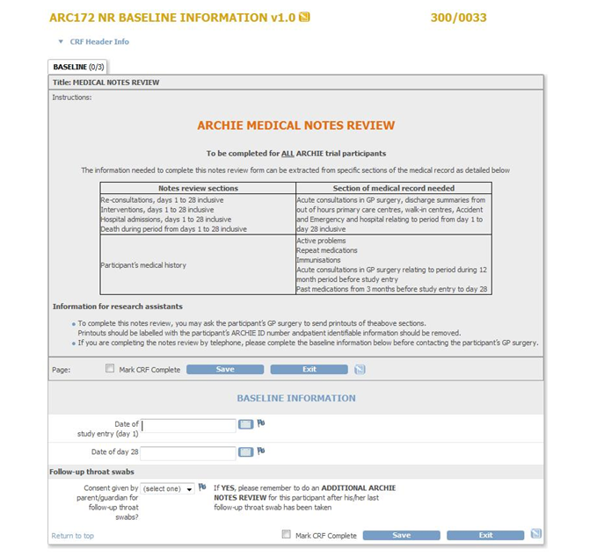
Baseline information
Notes:
When you open each CRF, the first thing you will see is a table which summarises which parts of the child’s medical record you will need to look at to complete each section of the notes review.
However, the baseline information CRF is very straightforward and only asks you to complete 3 items of information:
Date of study entry (day 1 of the study).
Date of day 28 of the study.
Whether or not the child’s parent or guardian gave consent for them to have additional follow-up throat swabs.

Slide 7
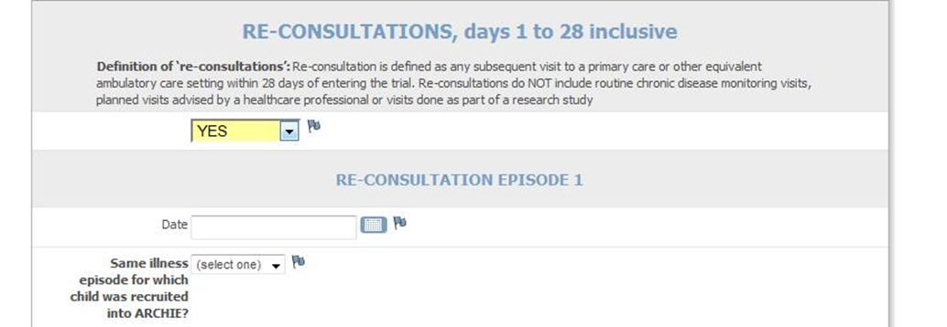
Re-consultations
N.B. Check scanned documents as well as consultations section of medical notes to identify re-consultations
Notes:
The next CRF will ask you about reconsultations, which we define as any unscheduled visit to a primary care or other equivalent ambulatory care setting within 28 days of entering the trial.
Please note that only unscheduled visits count as re-consultations. Therefore, planned visits, such as routine chronic disease monitoring visits, will not count as re-consultations.
Please also note that primary and ambulatory care settings include not only GP surgeries and GP walk-in centres, but also hospital emergency departments, day assessment units and specialist outpatient clinics – essentially any setting where a child might present acutely if their condition deteriorates. To ensure that you do not miss any re-consultations, please make sure you check the child’s scanned documents, as well as the consultations section of their medical notes, for any notifications or discharge summaries which might provide details of re-consultations in non-GP surgery settings.

Slide 8
Same symptoms as original presentation but worsening
Primary outcome:
Re-consultation due to clinical deterioration
Development of complications requiring medication or hospitalisation
Development of new symptoms
Notes:
Our primary outcome is specifically re-consultation due to clinical deterioration, which we define as children re-consulting with:
the same but worsening symptoms
New symptoms
Or complications requiring medication or hospitalisation
Therefore, for each re-consultation episode you report, the notes review screen will ask you for further details to help us decide whether or not the re-consultation was due to clinical deterioration.

Slide 9
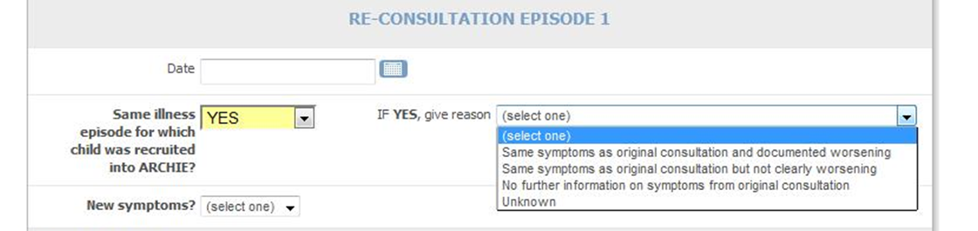
Reason for re-consultation
Notes:
Firstly, if the re-consultation occurred during the same illness episode for which the child was recruited into ARCHIE, we will need you to tell us the reason for this re-consultation by selecting from the options listed here.

Slide 10
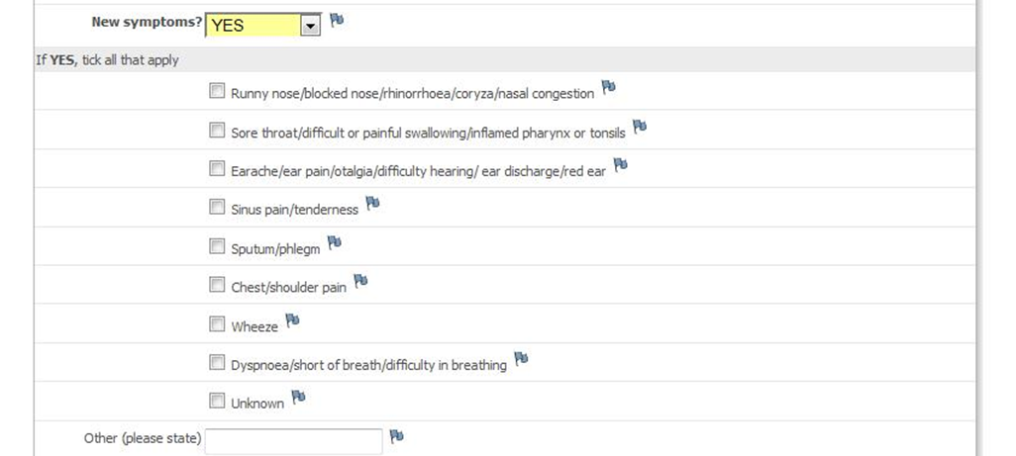
New symptoms
Notes:
We will then ask you whether any new symptoms were reported at the time of re-consultation and, if so, which.

Slide 11
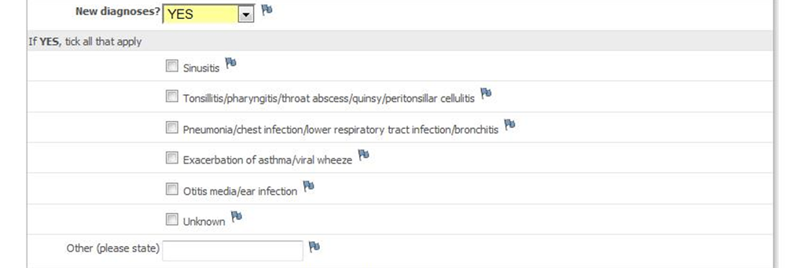
New diagnoses
Notes:
We will also ask you if any new diagnoses were recorded and, if so, which.

Slide 12
Interventions
Medications
Investigations
Referrals for acute hospital admission
Notes:
To help us understand more about the burden associated with re-consultations, we will ask you to provide further details of any interventions which occurred as a result of each re-consultation episode. These will include medications, investigations and referrals for acute hospital admission.

Slide 13
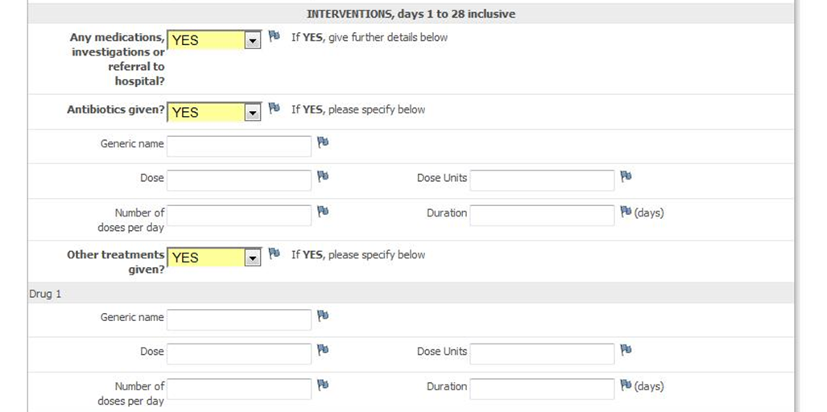
Medications
Notes:
In terms of medications, we will firstly ask you if the child received any antibiotics and, if so, which. We will also ask you to provide details of any other medications which the child received. If the child received more than one antibiotic prescription during the same re-consultation episode, please record additional antibiotics in the space provided for ‘other treatments’.

Slide 14
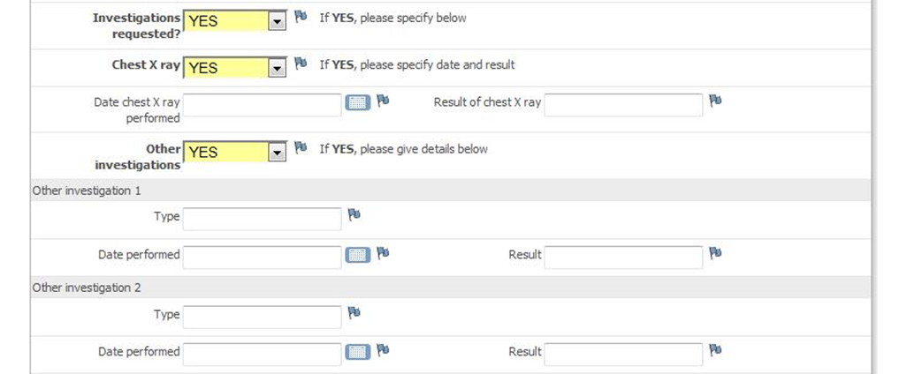
Investigations
Referral for acute admission
Notes:
We will also ask you to tell us whether the child had a chest X ray or any other investigations, or if they were referred for acute hospital admission as a result of their re-consultation episode.

Slide 15
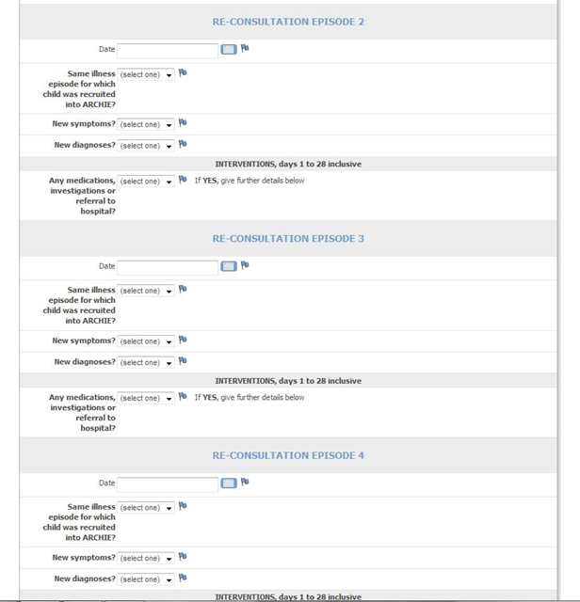
Notes:
We provide templates for you to record up to 4 re-consultation episodes. Please use the additional information CRF to record any further re-consultations.

Slide 16
Hospital admissions and deaths
Hospital admission = any acute admission to hospital for one or more nights from day 1 to day 28
Remember to report serious adverse events if not already done so
Notes:
The next two CRFs are about hospital admissions and deaths.
We define hospital admission as any acute admission for one or more nights from day 1 to day 28 of the study. If the date of admission was on or before day 28, please enter the hospital admission episode on the form, even if the date of discharge was after day 28.
As you will be aware, hospital admissions and deaths are by definition serious adverse events. So if you come across any which have not already been reported, please report them within 24 hours of becoming aware of the event.

Slide 17
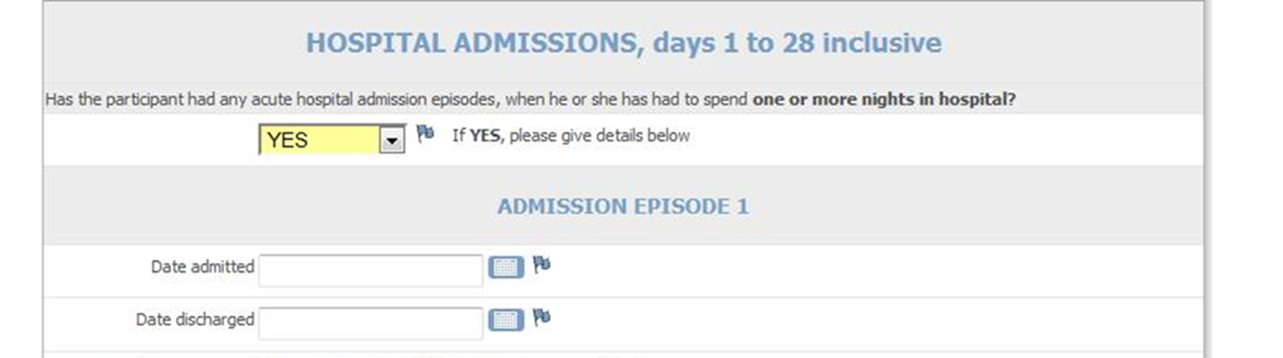
Hospital admissions
Notes:
We will ask you to enter admission and discharge dates for any hospital admissions you report.

Slide 18
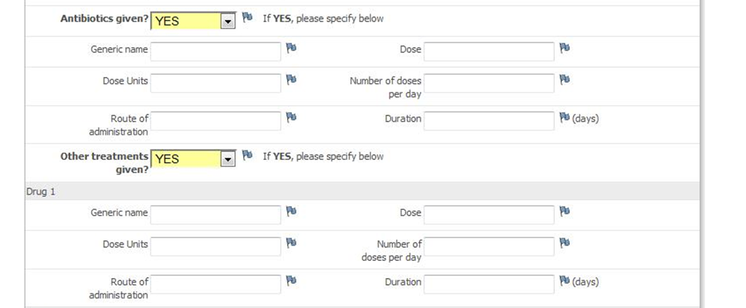
Antibiotics and other treatments
Notes:
Again, to help us understand more about the burden associated with hospital admissions, we will ask you for further details about any antibiotics or other treatments prescribed during each admission.

Slide 19
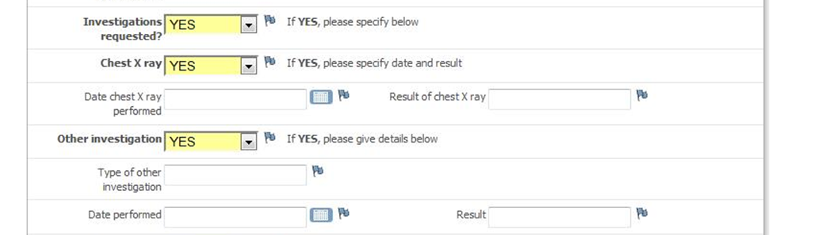
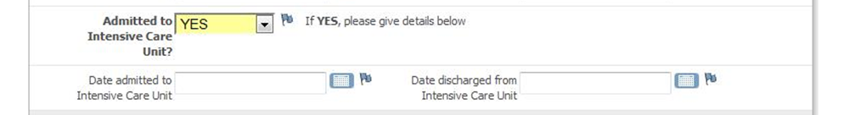
Investigations
Intensive Care Unit admissions
Notes:
Next, we will ask you about any investigations which took place during the hospital admission and any Intensive Care Unit admissions together with admission and discharge dates.

Slide 20
Medical history
‘At risk’ medical problem
Regular medications at time of study entry
Vaccinations
Acute consultations during 12-month period before study entry
Antibiotics given during 3-month period before study entry
Notes:
The last CRF which will apply to all children is the CRF on medical history, which will cover the areas listed here.

Slide 21
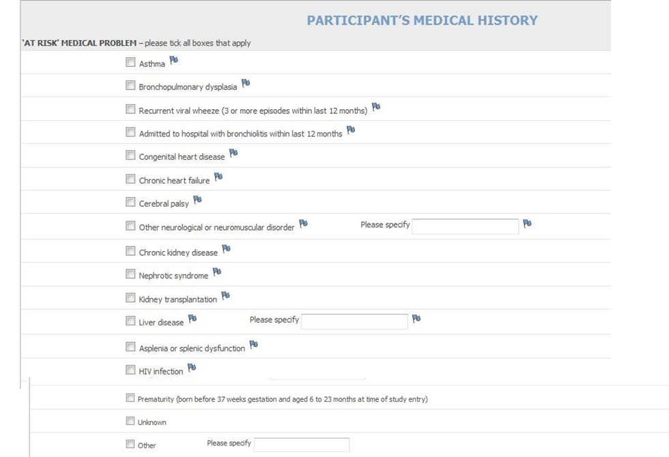
Notes:
Firstly, we will need you to indicate which ‘at risk’ medical problem or problems apply to the child. We provide a fairly comprehensive list of these, not all of which are displayed on this slide. However, if the child has a medical problem which is not listed in the options we provide, you will need to select ‘other’ and enter the problem in the space provided.

Slide 22
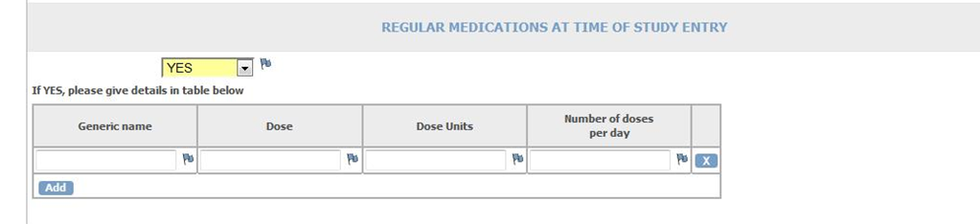
Regular medications
Notes:
Next we will ask you for details of which medications the child was taking regularly at the time they entered the study. To add additional medications, click on the ‘Add button’, which will create a new row for you in the table.

Slide 23
Vaccinations
Haemophilus influenzae b (Hib)
Pneumococcal conjugate vaccine (PCV)
Prevenar or Prevenar 13
Influenza
Same season as recruited
Previous season
Pandemic
Notes:
We will need you to provide us with details of whether or not children had received the Hib, pneumococcal and influenza vaccinations at the time of study entry.

Slide 24
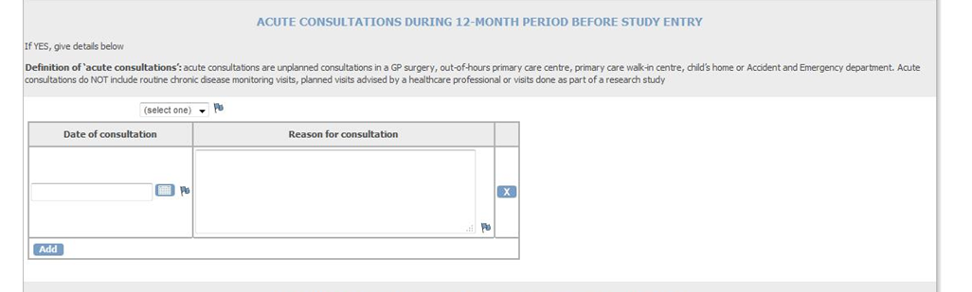
Acute consultations
Notes:
We will also ask you to provide any details of acute consultations during the 12 month period before study entry because there is some evidence that more frequent consulters are also more likely to re-consult. Again, we are only looking for unplanned or unscheduled visits. You only need to give a brief reason for the consultation – for example, it may be sufficient to just enter the Read code for a GP surgery consultation.
To add new rows for more acute consultations, click on the ‘Add button’.

Slide 25
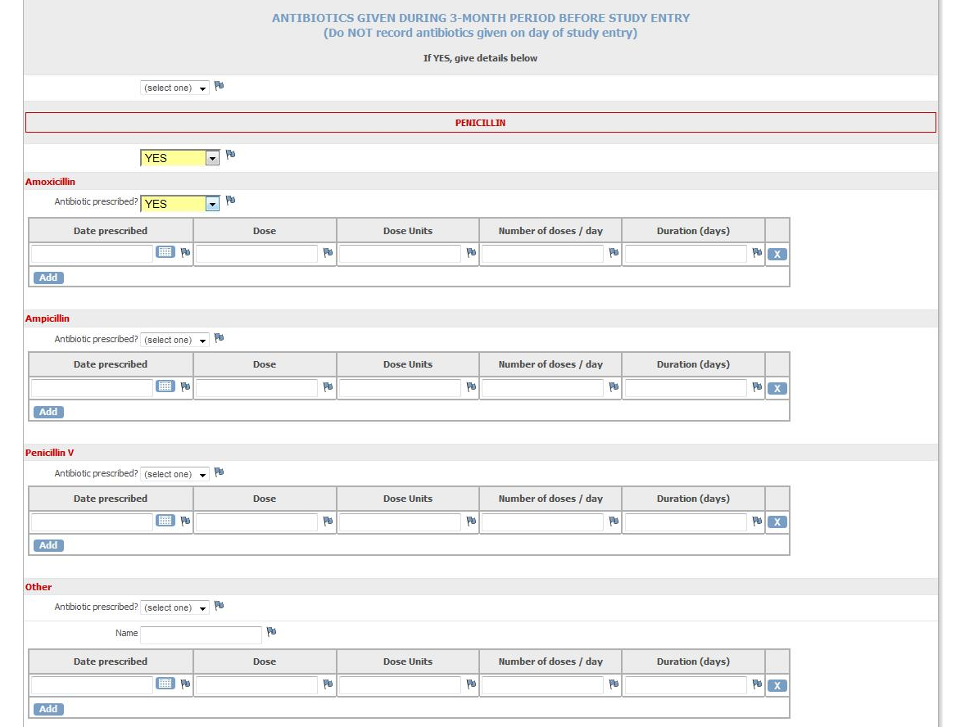
Antibiotics
Notes:
To help us interpret our throat swab results on antimicrobial sensitivity, we will need you to provide details of antibiotics given during the 3-month period before study entry.
We will ask you to enter details of the antibiotics prescribed, firstly according to the class of antibiotic, and then by selecting or providing the generic name, date prescribed, dose, and duration.

Slide 26
Additional notes review
Only required for children from whom additional throat swabs obtained
Antibiotics up to 12 months after study entry
Follow-up throat swab timings: 3, 6, 12 months
Notes:
If additional throat swabs are obtained from the child, we will also need you to provide details of antibiotics prescribed up to 12 months after study entry by completing the additional notes review CRF. The study team will remind you when this additional notes review is due.

Slide 27

Thank you for listening
Notes:
So that covers how to complete the medical notes review for our study. Thank you for listening and please get in touch with the study team if you have any questions.

