Slide 1

Online systems
ARCHIE
02/02/2015

Slide 2
Contents
Access
Website
Sortition (randomisation)
OpenClinica (data entry)

Slide 3
Access
After you have send us the ‘Access to online systems’ form you will receive an email from ARCHIE data: ARCHIE study - online systems accounts
This email will contain your username and initial passwords for the systems you have signed up to

Slide 4
Password
You can have the same password for all systems if it meets the criteria below:
Between 8 and 16 characters
A number
A lowercase letter
An uppercase letter
A special character (!£$%*@#)

Slide 5
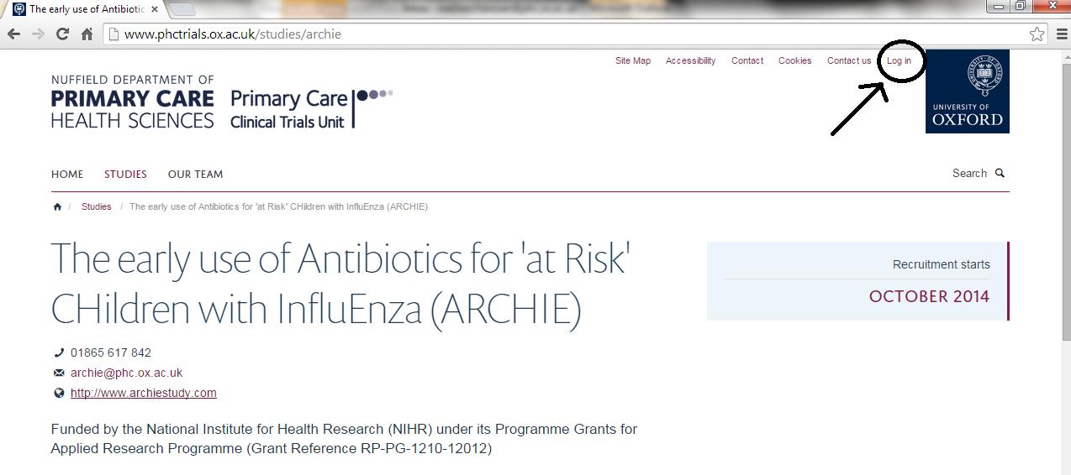
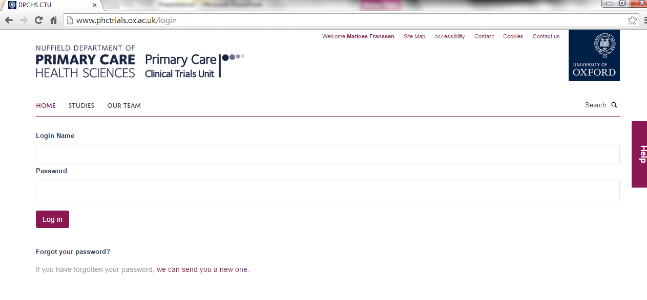
Website
Notes:
www.archiestudy.com will take you to the top screen; if you click on log in you will be taken to the bottom screen. Use login name and password send by email, you will need to change your password

Slide 6
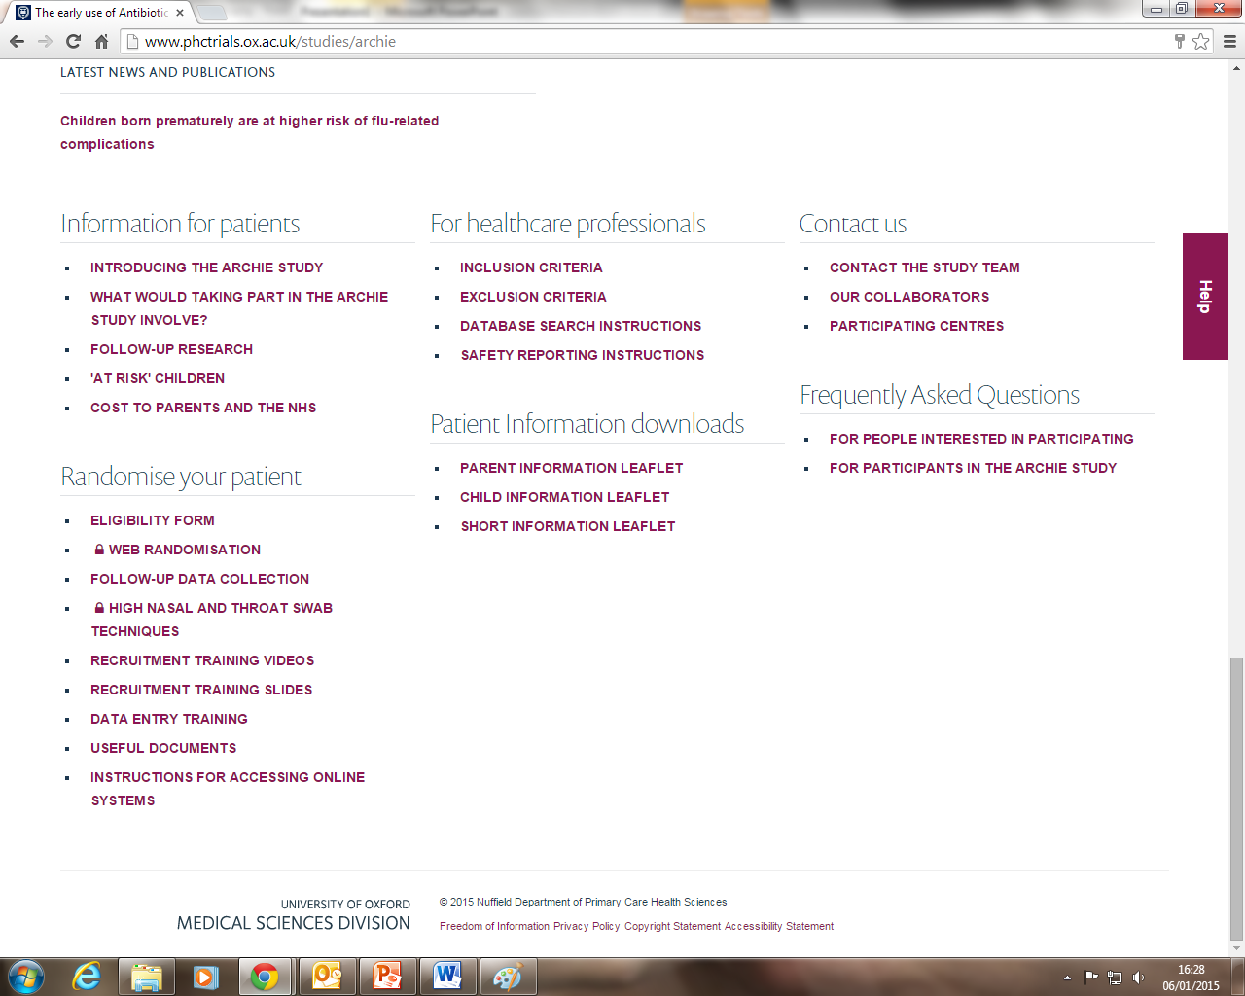
Website information
Notes:
At the bottom of the website, the following information is available.

Slide 7
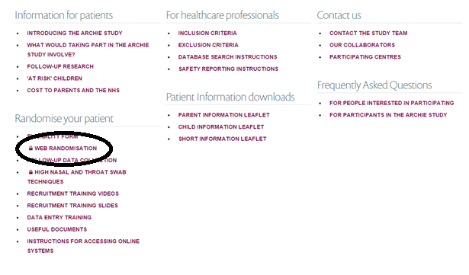
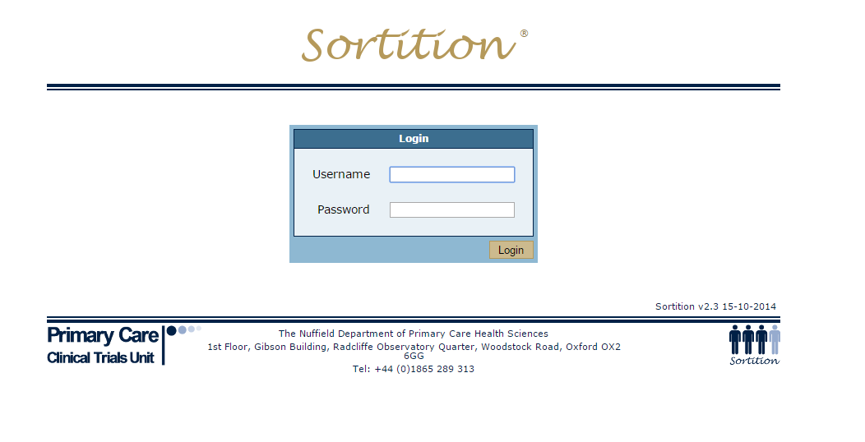
Sortition
Notes:
Via de website you can go to the Sortition website (for randomisation). Use username and password provided to log in.

Slide 8
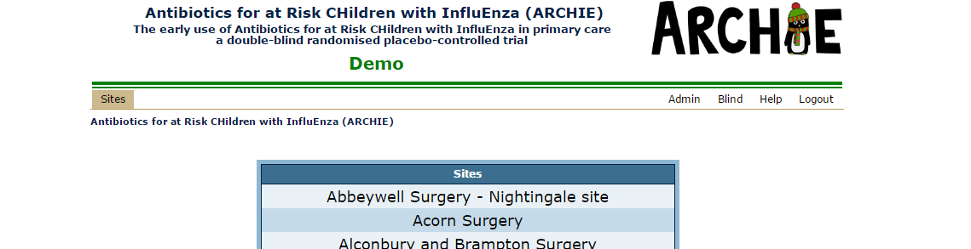
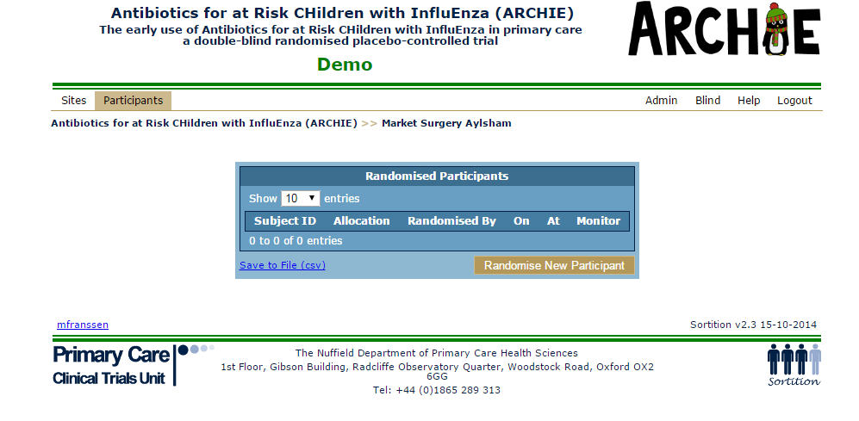
Notes:
The next screen will say DEMO in green, once you have signed the online training sheet and we have the drugs this will change to LIVE in red. You can click on your site in order to proceed. Click on randomise new participant

Slide 9
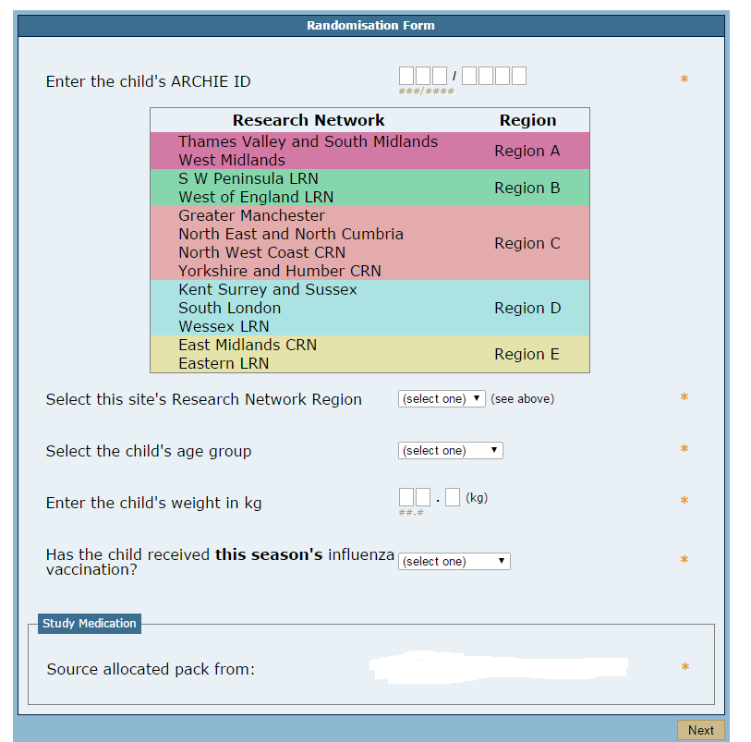
Notes:
Here you can fill out the necessary details. Your blue recruitment pack should have all the information. “Source allocated pack from:” should have your site listed

Slide 10
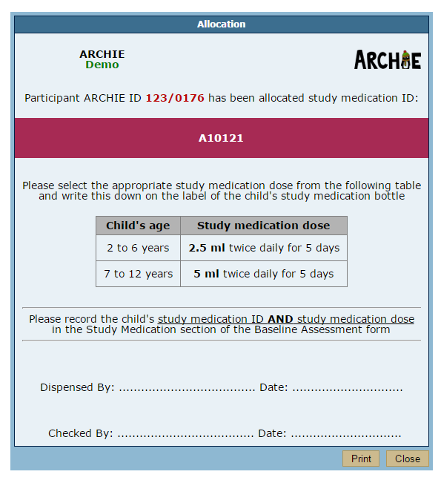
Notes:
After you have filled out all the information you will be taken to this screen. You can print the label and sign it off.

Slide 11
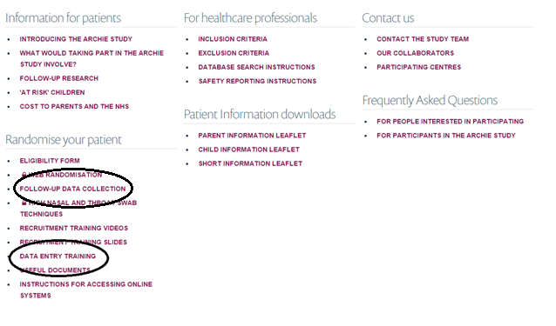
OpenClinica Manual
Notes:
On the website you can find the link to go to OpenClinica to input your data (follow-up data collection). Furthermore, you can find a comprehensive manual on how to use OpenClinica (under data entry training)

Slide 12
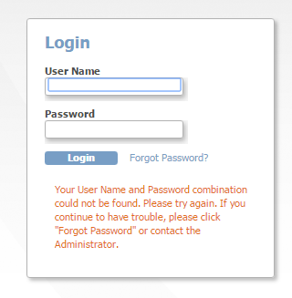
OpenClinica
Notes:
Please be aware that the log in you have received initially will only take you to the demo version of OpenClinica. The link on the website will take you to the live version.

Slide 13
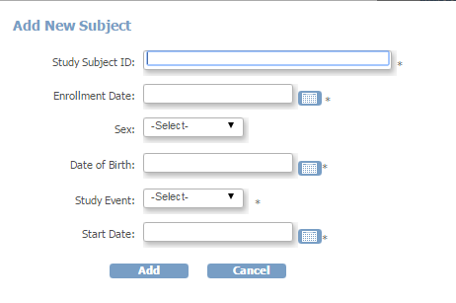
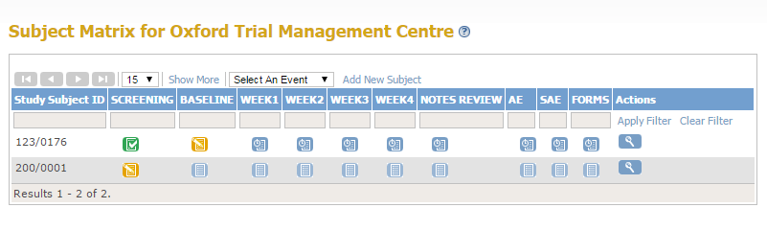
Notes:
The top screen is a display for inputting a new patient into open clinica. The bottom gives an overview of the participants that are in Open Clinica and information on how data inputting is coming along.

